Slide 1
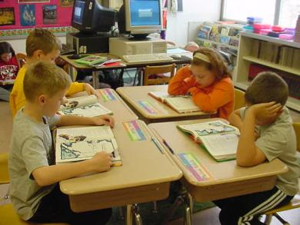
From Reading Journal to Reciprocal Teaching to Reading Reflection Contest
101年度臺南市國中英語領域『創意閱讀教學策略』精進工作坊
創意閱讀教學
台南市立永仁高中 蔡孟芬老師
Read Together, Work Together and Enjoy Reading Together

Slide 2
講師介紹
蔡孟芬
English Teacher in Tainan Yong Ren High
School
2011, 2012 Expert Teacher of English Resource Center (英文學科中心種子教師)
100 年「教育部高中資訊科技融入教學資源創意應用徵選活動」優等獎

Slide 3
9 Reasons to Quit Teaching
1. Bad students 2. Bad administrators 3. Bad curriculum 4. Too much paperwork 5. Too much negativity 6. Too much responsibility 7. Not enough time 8. Not enough credit 9. Not enough pay
Source: Teaching Community

Slide 4
Because children are worth it.
Because you are passionate about your subject matter.
Because there is more personal satisfaction in this field than any other.
Because giving of you is truly living.
Because you have something valuable to share.
Because you enjoy learning.
Because you need to make a difference in lives.
Because there are too many teachers who don’t want to be teaching.
Christmas Break.
Summer Vacation. Source: Teaching Community
10 Reasons to Stay Teaching

Slide 5
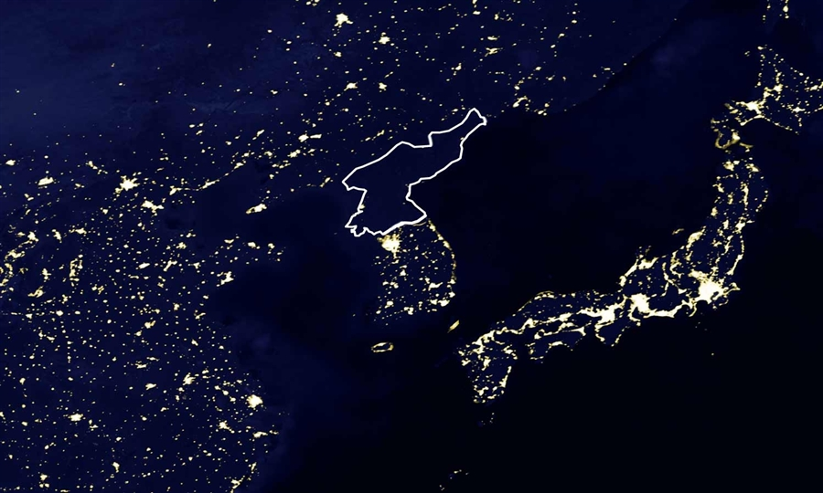
The darkness shows how much North Korea has lagged behind its neighbors.

Slide 6
Taiwan’s Story… from an Singapore Deputy Prime Minister 2012-04-12
Singapore risks becoming a 'Taiwan story' and will lose its competitive edge globally if it closes its doors to foreign talent.
On this question, he has given a clear answer: "Even if we don't have foreigners here, you are still competing with foreigners somewhere else."

Slide 7
To get rid of “Taiwan’s Story”….
We can not stay in the ivory tower any more. The next Taiwan generation must have the ability to stand and perform on the international stage.

Slide 8
教育部中小學國際教育白皮書 100.04
Ministry of Education
未來將透過學校國際交流、多語言能力培養、國際教育教師交換、國際教育課程統整和教材研發等推動策略，培養學生世界公民意識，提高學生適應全球化的生活和國際競爭力。

Slide 9
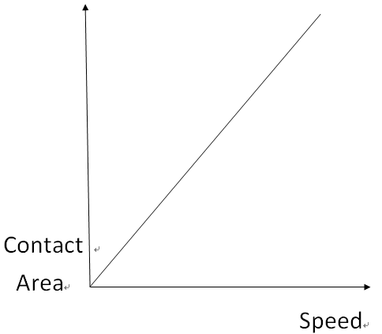
In a chemistry experiment…
The larger contact areas are, the faster the reaction will be.

Slide 10
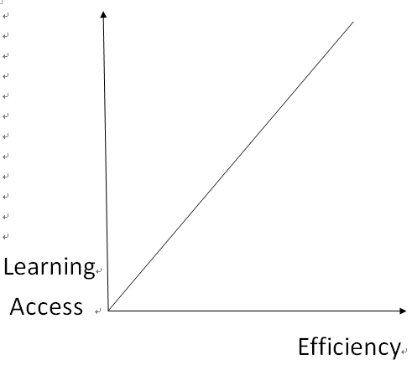
In an English classroom…
If teachers provide as many accesses as possible, students’ learning efficiency will be improved.

Slide 11
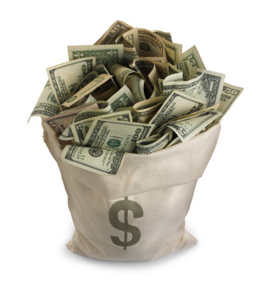
Limited financial support?
Students with limited English ability?

Slide 12
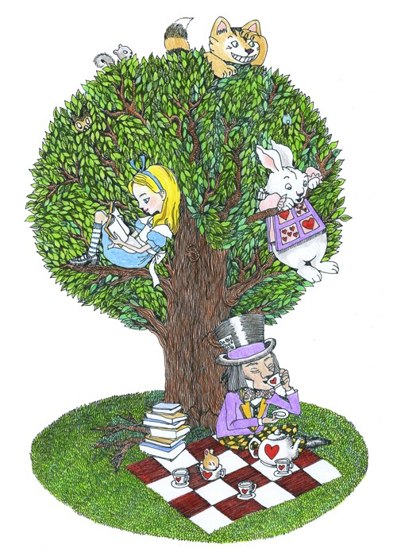
From Reading Journal to Reciprocal Teaching to Reading Reflection Contest 從閱讀日誌、交互教學法 到閱讀心得比賽

Slide 13
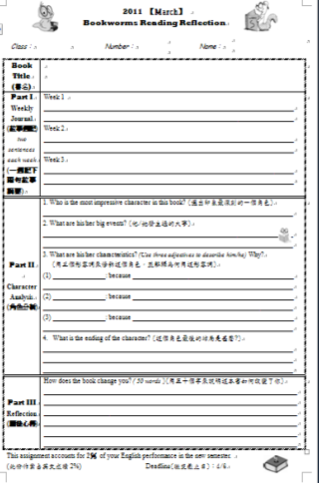
2010 Autumn
Monthly Reading Reflection
on Oxford Bookworms
Appendix 1
Level 1的400字
至Level 6的2500字
Level 1適用全民英檢初級 ，
Level 2、3適用全民英檢中級
Level 4、5、6適用全民英檢中高級。

Slide 14
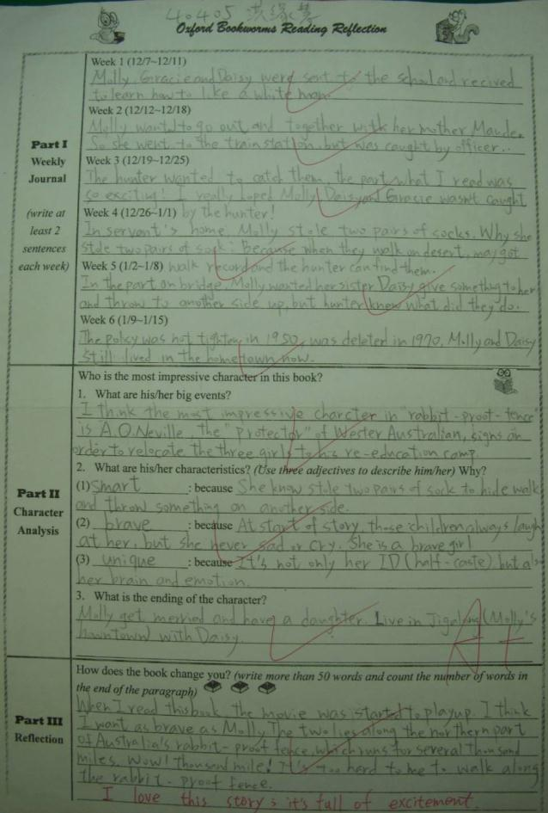
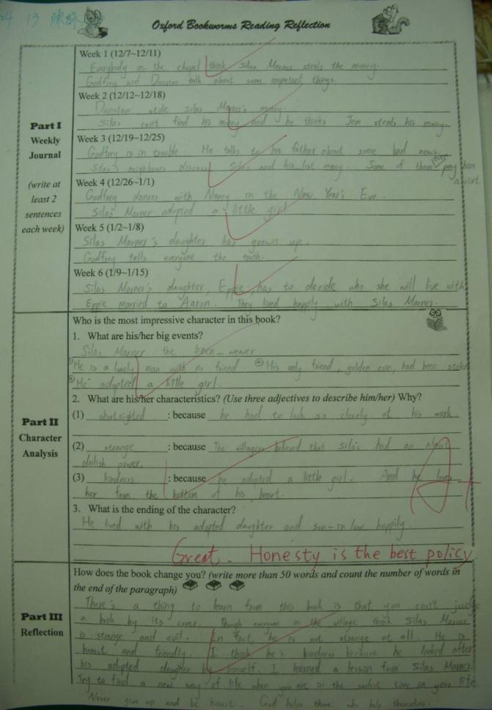
2010 Students’ Reading Reflection Works

Slide 15
Advantages—
Free time management
Spreading pressure
Lightening the load
Disadvantages—
Bad time management
Finishing in the very beginning
Assignment delay

Slide 16
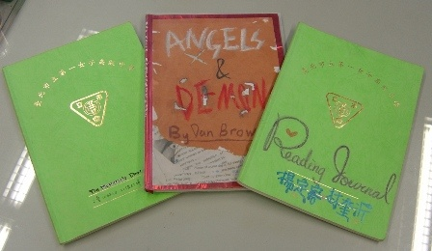
2011 Spring
Workshops for Expert Teachers of English Resource Center
Taipei First Girls High School 葉中如老師
Reading Journal

Slide 17
fail
Reflection
My students need guiding and training.

Slide 18
2011 Autumn
Reading Journal in Yung Zen High School
Book Selection: The Trumpet of the Swan
Period：one semester
Participants: The whole class, two or three (when necessary) people in a group
Assignment：one journal each week
Places: Anywhere of your own choice (e.g. your home, the school, the internet…)

Slide 19
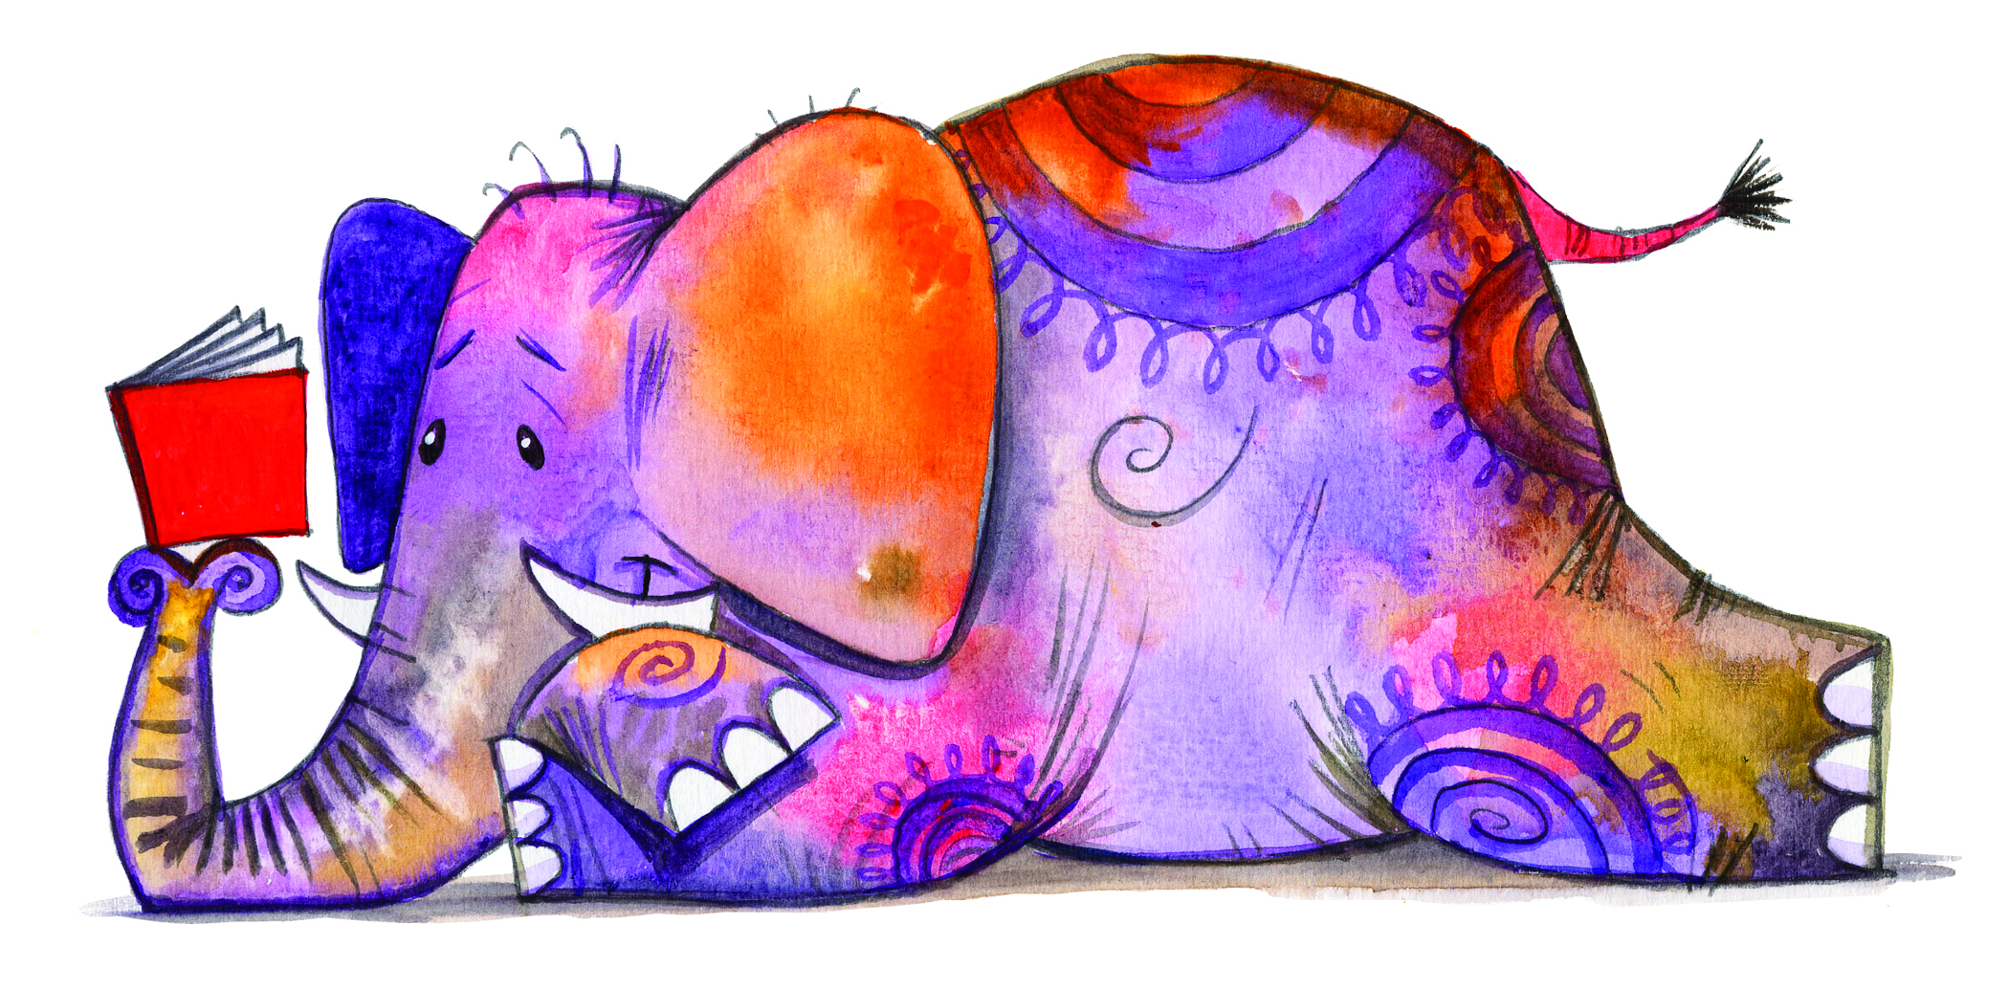
2011
Students work in pairs and take turns being Partner A or Partner B every week
 | Partner A | Partner B
Dec. 3-9 | Lily Summary, questions, etc | Rachel Answers to the questions
Dec. 10-16 | Rachel Summary, questions, etc | Lily Answers to the questions
Dec. 17-23 | Lily Summary, questions, etc | Rachel Answers to the questions
Form
(Appendix 2)

Slide 20
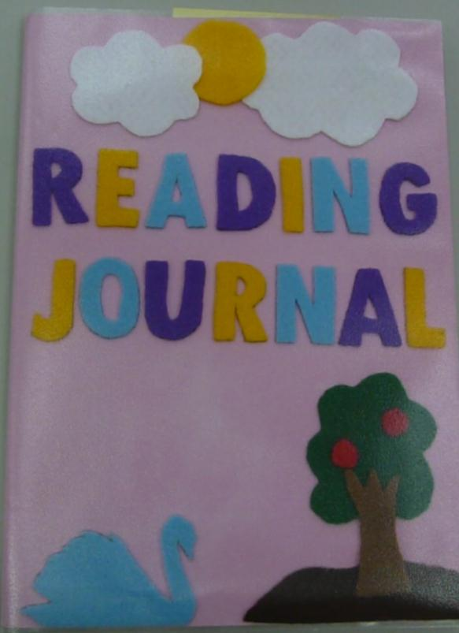
2011
The first week—preparation
1. Students design the cover of their RJ.

Slide 21
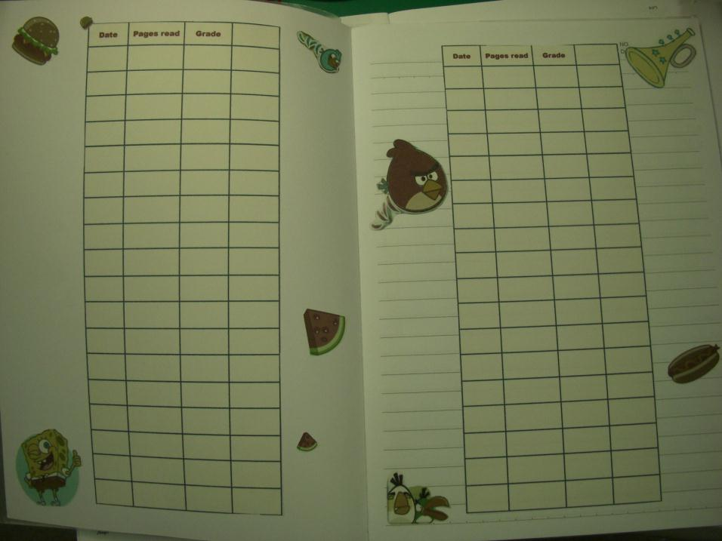
2011
They make the inside of the cover & Page 1to record the process.

Slide 22
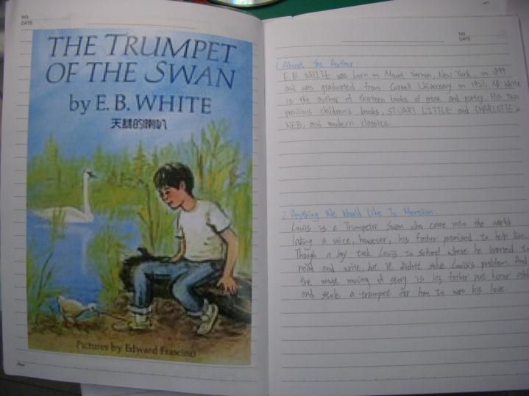
2011
Finally, students complete page 2 & 3.
Page 2: the book cover (photocopied, printed, or hand-painted)
Page 3: a brief introduction to the book and the author

Slide 23
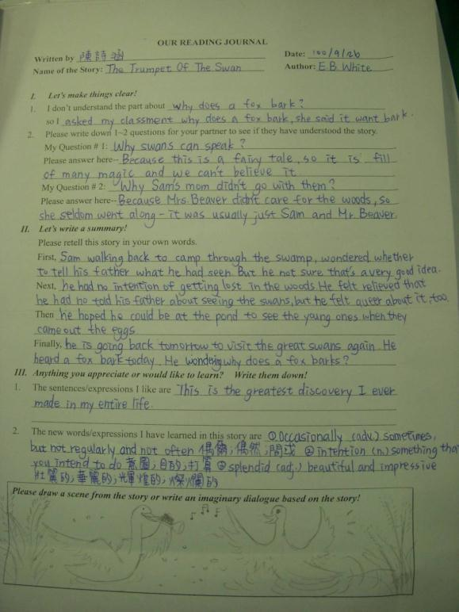
2011
The second week— Individual Exercise
Students act as Partner A & B at the same time to make sure they know the duties of two roles.
Appendix 3

Slide 24
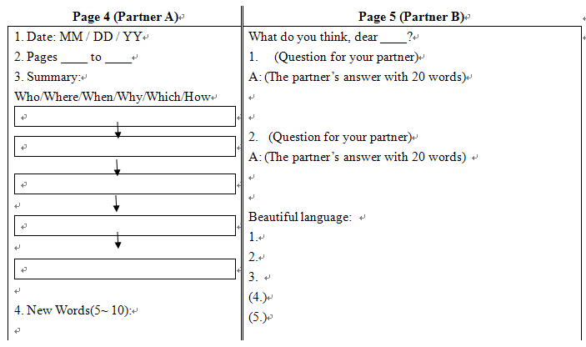
2011
The third week—formal RJ
Partner A
Page 4：summary (bonus: graphic organizer) and vocabulary (you would like know)
Page 5：asking two questions

Slide 25
2011
Partner B
Page 5：answering two questions and write beautiful language in the pages read

Slide 26
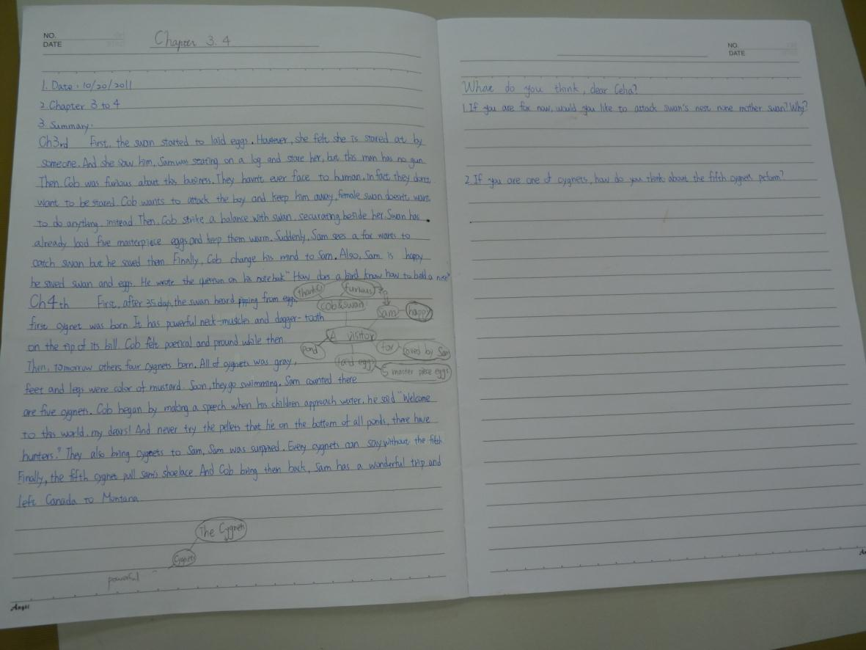
2011
Partner A sample

Slide 27
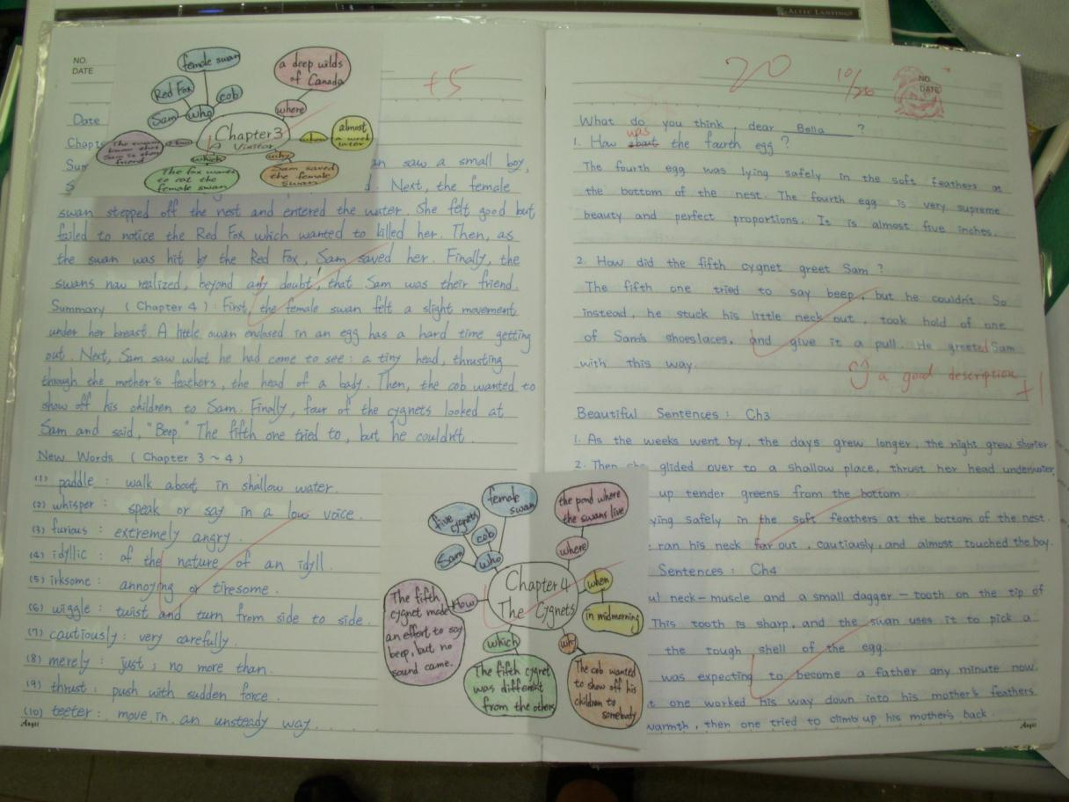
2011
Partner B sample

Slide 28
Reflection
2011
1. Not all students liked the book selected by the teacher.
2. Students of different levels needed different books.
3. Some would rather work individually because their partners became big barriers.
4. Handing in RJ almost every week made students stressed.
5. Students did not know what parts they needed to improve.

Slide 29
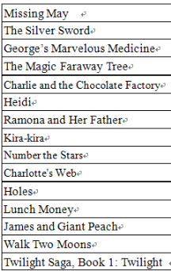
2012
2012 Spring
Book Selection: 15 storybooks
Period：one semester
Participants: The whole class, single or two in a group
Assignment：one journal every two weeks
Places: Anywhere of your own choice (e.g. your home, the school, the internet…)

Slide 30
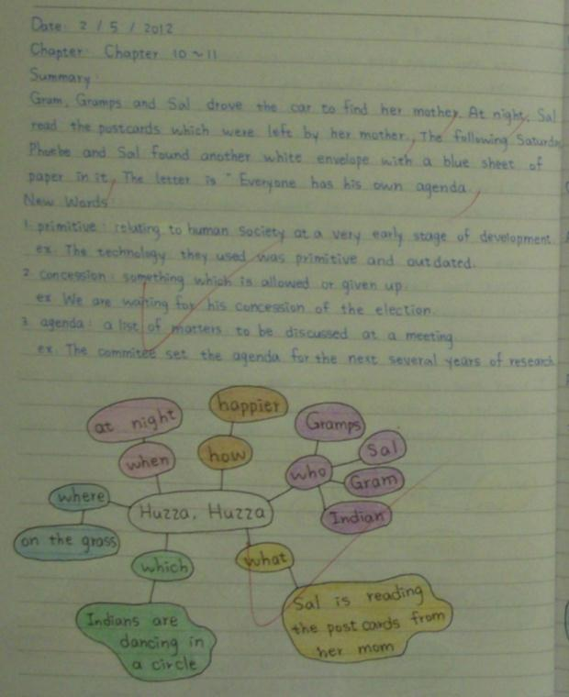
2012
Partner A
Page 4：summary & graphic organizer and vocabulary & example sentences
Page 5：asking two
questions

Slide 31
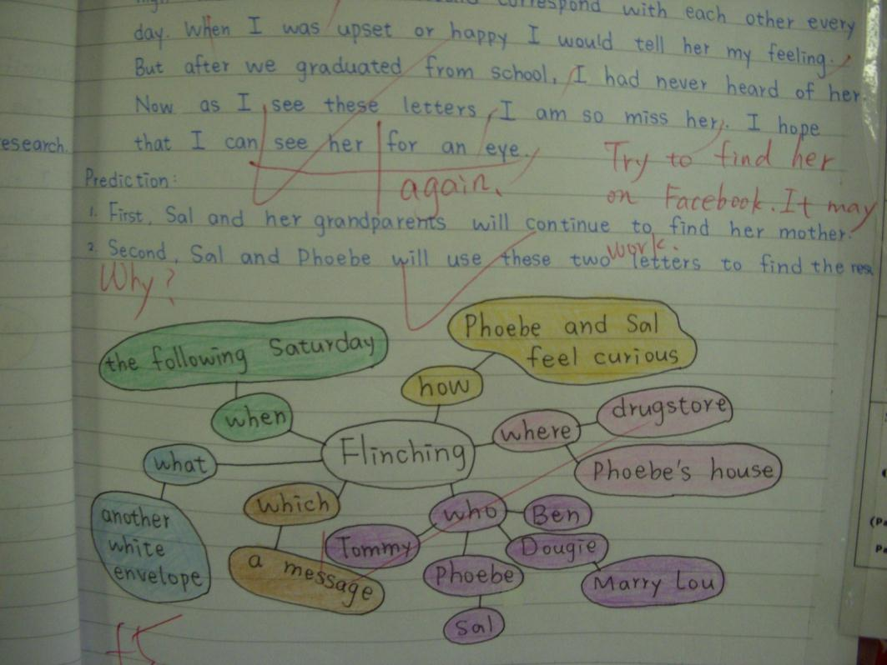
2012
Partner B
answers two questions and guesses or predict about what the author will tell next.

Slide 32
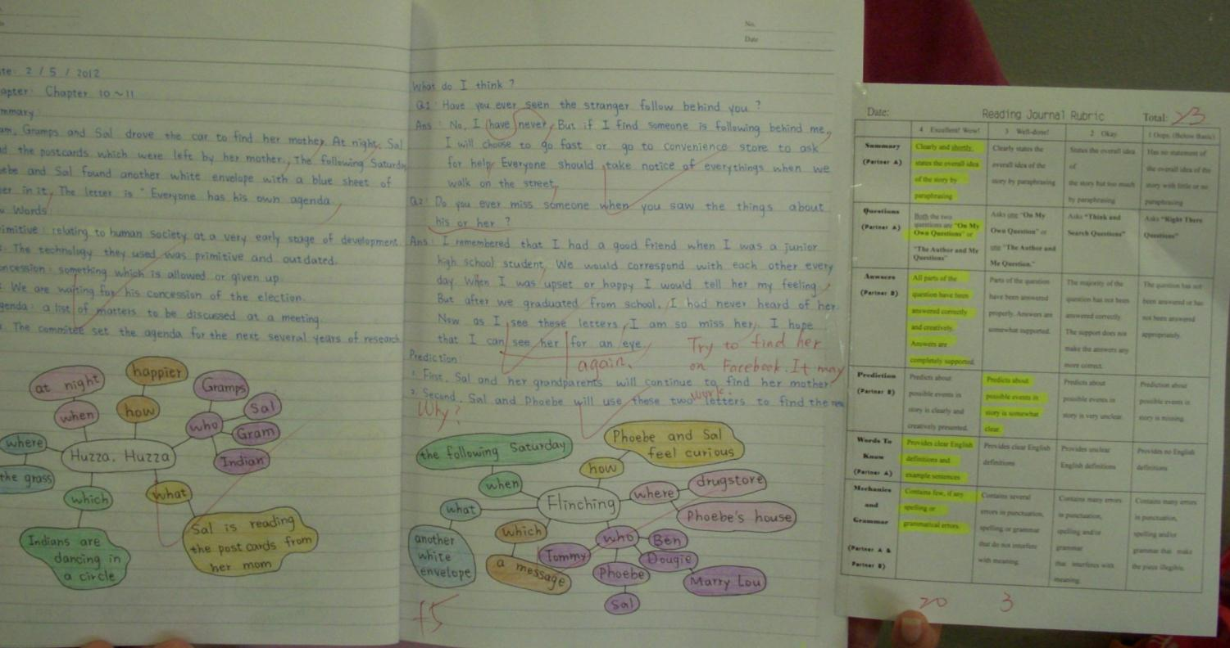
Rubrics for Reading Journal

Slide 33
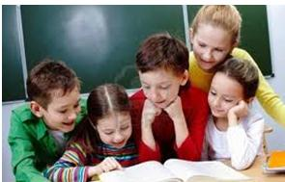
Training in English Classes

Slide 34
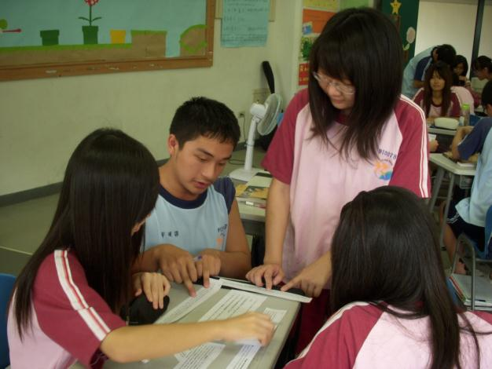
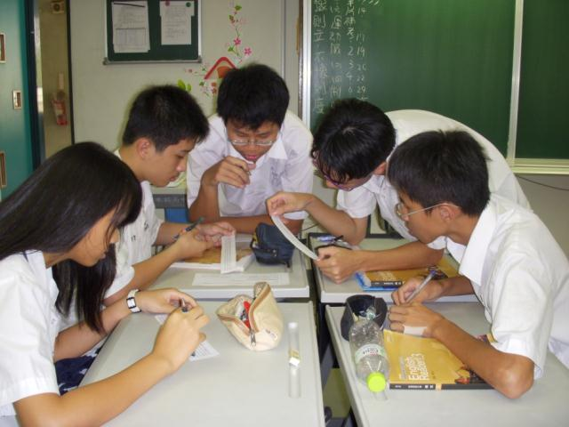
I. Summary Writing Training
Long Teng English Book 3 Lesson 8
Finding the Topic Sentence and Putting the Paragraphs in correct orders

Slide 35
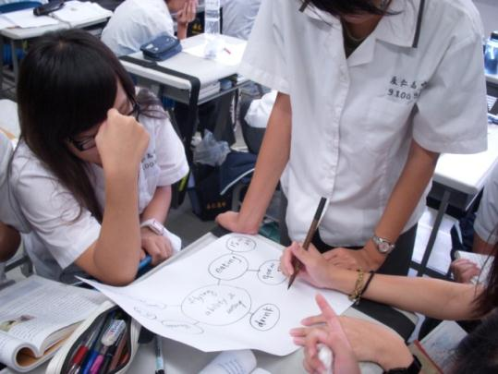
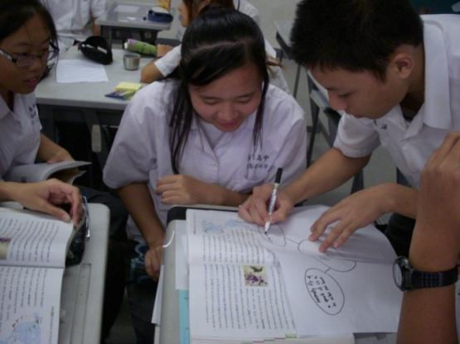
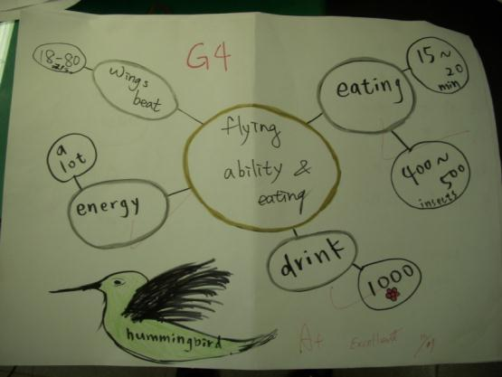
2. Graphic Organizer Training
Using Graphic Organizers to enhance comprehending the text
Each group was in charge of one paragraph

Slide 36
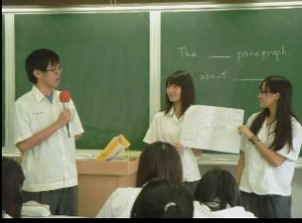
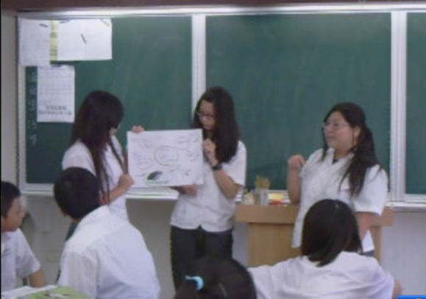
Mini Reports with Graphic Organizers

Slide 37
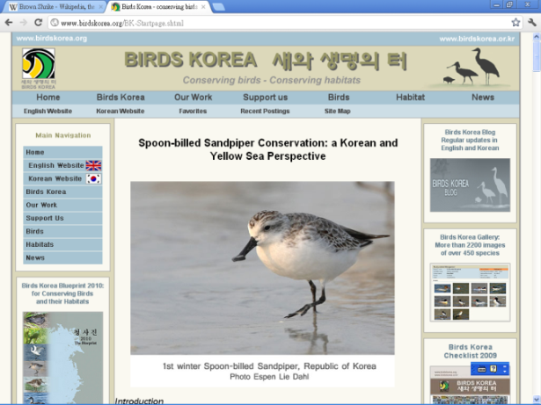
Report Common Birds of Taiwan
in computer classroom
Black Drongo
Japanese White-eye
Brown Shrike
Night-Heron
Little Egret
Gray-faced Buzzard
Black-faced Spoonbill

Slide 38
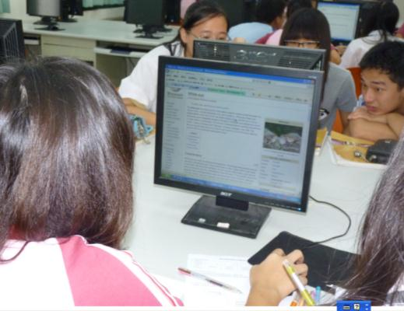
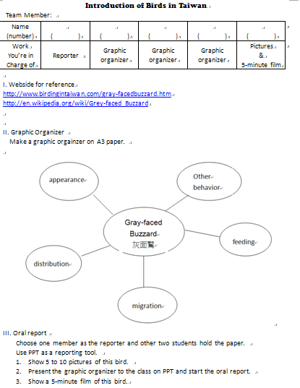
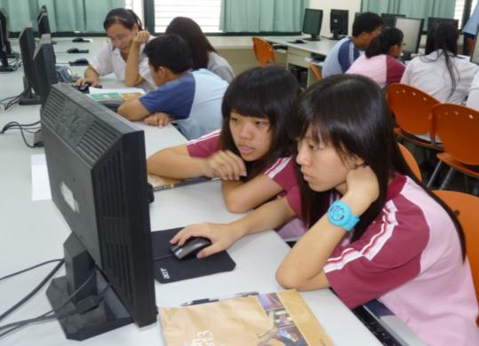
Common Birds of Taiwan Oral Report

Slide 39
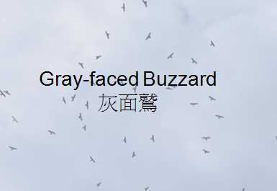
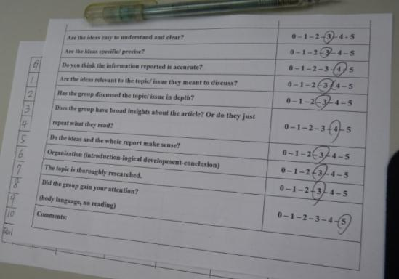
Common Birds of Taiwan Oral Report

Slide 40
4. Asking Questions Training
The following are four types of questions for your reading journals
In the Text
Right There Questions
Think and Search Questions
In My Head
Author and Me Questions
On My Own Questions
Appendix 4

Slide 41
Raising Questions in Textbooks

Slide 42
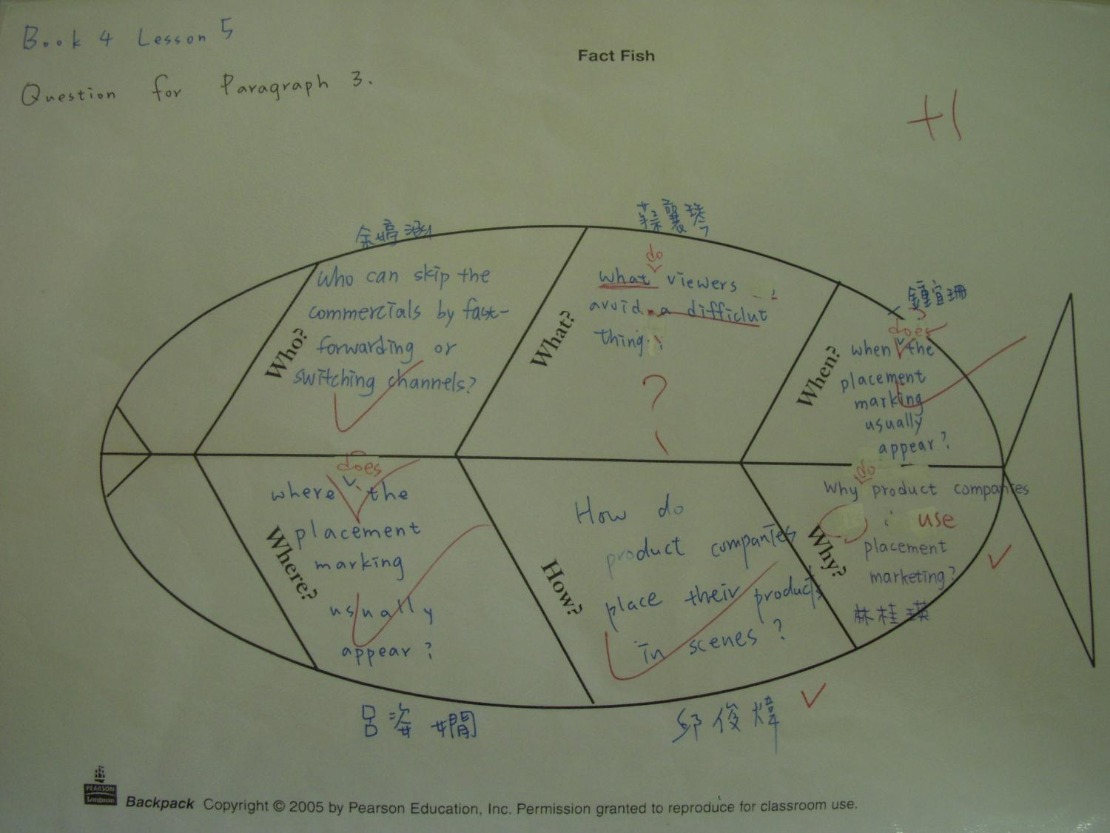

Slide 43
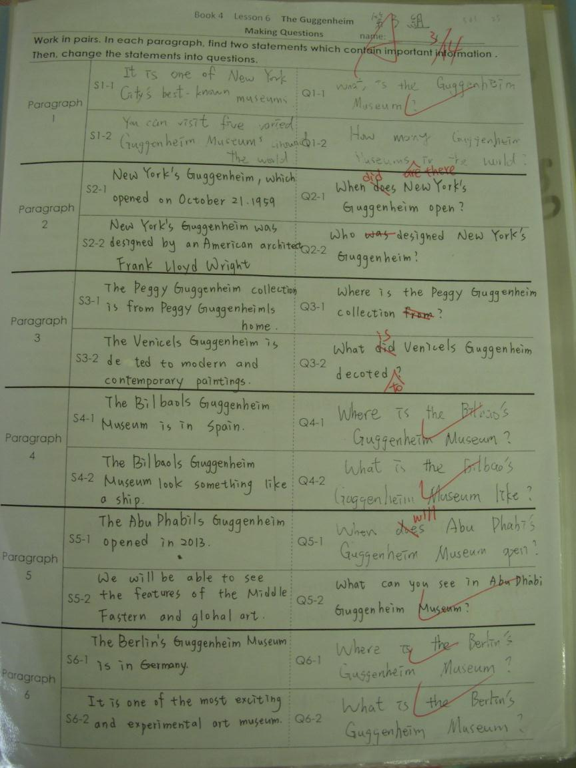

Slide 44
Questions for Chapter 9 & 10 of The Trumpet of the Swan
If your father stole something as your birthday gift, would you accept it?
Why did the cob repeat saying that he sacrificed his honor and pride?
If you were the swan, would you stop your husband from robbing the trumpet from the music store? Why?

Slide 45
Will your mom remind you of so many things before you leave home for a few days? Why?
Have you ever think of what you are going to be when you grow up? Why?
Do you believe that Rome wasn’t built in a day and all your efforts will pay off, that’s for sure? Why?

Slide 46
5. 交互教學法（Reciprocal Teaching）
利用摘錄重點（summarizing）、提出問題（questioning）、澄清（clarifying）、以及預測下段文章內容（predicting）等四種活動，教導學生學習如何應用有效的閱讀策略。
交互教學法的「對話」結構與交互作用需要學生的參與，可以培養不同能力階層學生之間的相互關係。
老師則透過交互教學法，增加評定學生進步情形的機會，有更多的時間與小組共同活動，來增加學生的閱讀能力。
來源: 陳穎の特教考題

Slide 47
2011
Reciprocal Teaching
Strategies for Reading Comprehension
Summarizing: summarizes the main idea of the section
Questioning: writes down two questions
Clarifying: copies down any words, phrases or sentences that are unclear
Predicting: writes down the prediction about the story will cover

Slide 48
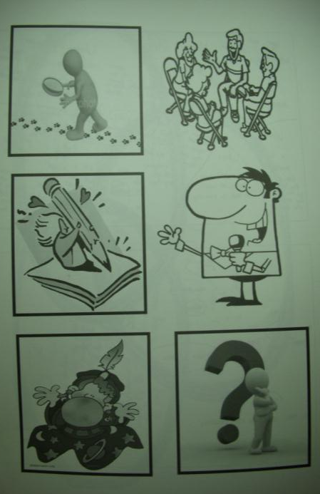
Distribute one card to each member of the group identifying each person's unique role.
Summarizer
Questioner
Clarifier
Predictor
Group leader
Reporter

Slide 49
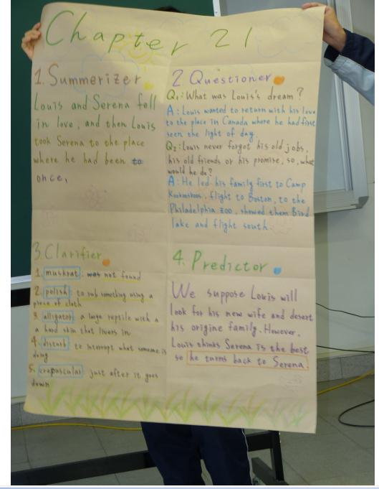
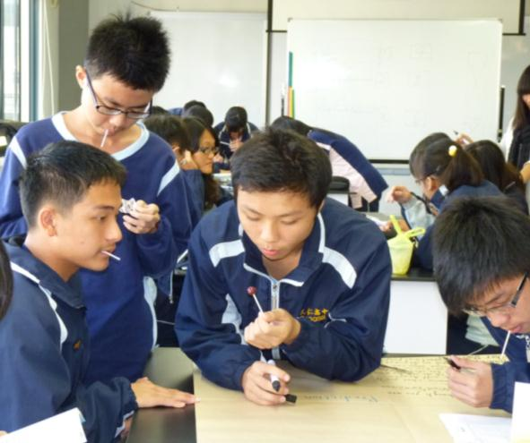
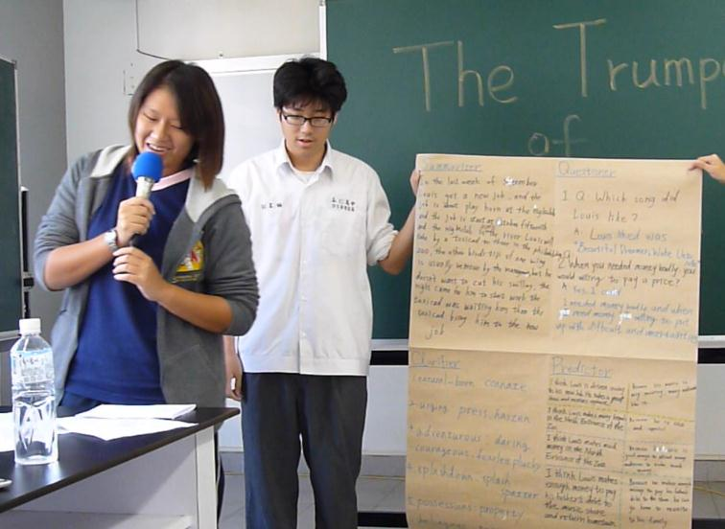
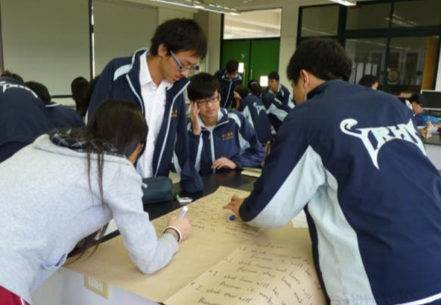
Reciprocal Teaching on The Trumpet of the Swan Chapter 16~21

Slide 50
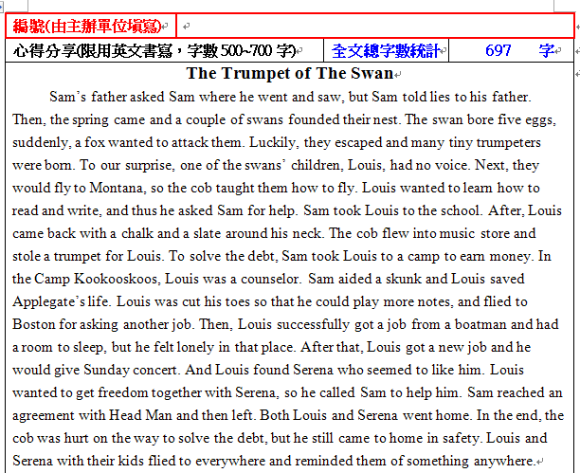
2012
Reading Opens Your World
書林第二屆全國高中職英文讀書心得比賽
辦法

Slide 51
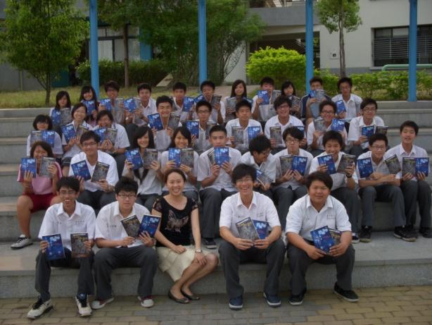
2012
班級全體報名，可獲精選英文好書每人一本
及參賽證明

Slide 52
2012
台南市立永仁高級中學100學年度第2學期英文科IWill線上閱讀競賽辦法
2012 IWill Reading Challenge in Yong Ren High School
辦法

Slide 53
2012

Slide 54
2012

Slide 55
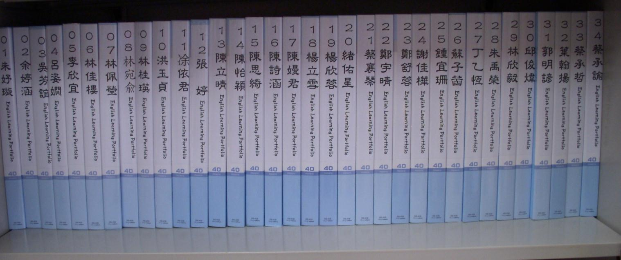
How to Get Students Involved in the Activities

Slide 56
Try and fail. But never fail to try.
Give our students opportunities and encourage them to keep going. They can do much more and better than we think.

Slide 57
Read together, work together, and enjoy reading together!
Q & A
2012

Slide 58
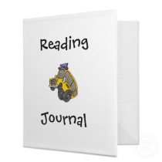
Exercises—Reading Journal
Book: Another World
Group: Two persons in a group
Partner A & Partner B
Journal: Appendix 7

Slide 59
