Slide 1
補救教學基本學習內容轉化設計研習（一）
時間：102年04月12日
地點：台南市玉井國中
主講人：台南市國中英語輔導團專任輔導員
台南市崇明國中梁玲瑜老師

Slide 2
Remedial Teaching
1002補救教學 教材內容及參考資料
編製:崇明國中 梁玲瑜 老師
崇明國中:實習教師:葉紫緹
實習教師:黃于昕

Slide 3
Do you have a red pen ?
1002Grade 8, Unit 3

Slide 4
Sentence Pattern
Do you have a red pen?
○ Yes, I do.
✗ No, I don’t.

Slide 5
First Class Teaching goal
Learn to use the sentence pattern:
”Do you have…?”/
”Yes, I do. or No, I don’t.”

Slide 6
Warm-up
Ask Ss “Do you have a red pen?”
Play a song to ask Ss try to follow the sentences in the video

Slide 7
Let’s Practice!
http://www.youtube.com/watch?v=rV7X2T7nJ8o&feature=related

Slide 8
Presentation
Show the pictures and pronunciation of the vocabulary in the video.
Ask Ss to repeat after T

Slide 9
1st Step: Answering Machine!

Slide 10
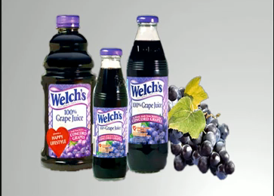
grapefruit (n.) 葡萄柚
grape juice (n.) 葡萄汁

Slide 11
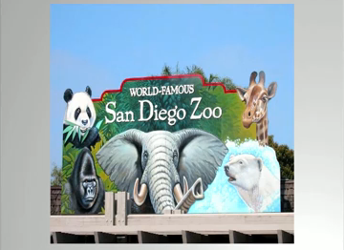
zoo (n.) 動物園
kimchi (n.) 泡菜

Slide 12
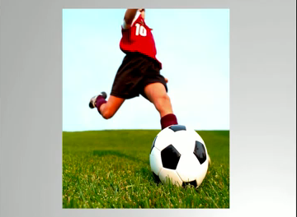
soccer (n.) 足球
snake (n.) 蛇

Slide 13
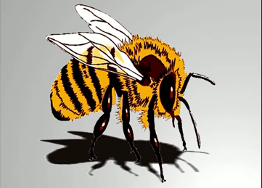
bee (n.) 蜜蜂
shark (n.) 鯊魚

Slide 14
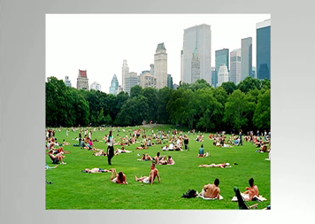
park (n.) 公園
candy (n.) 糖果

Slide 15
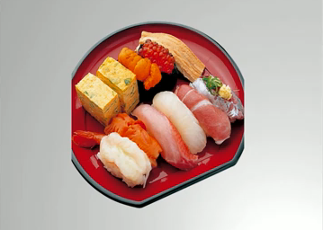
sushi (n.) 壽司
wasabi (n.) 哇沙米

Slide 16
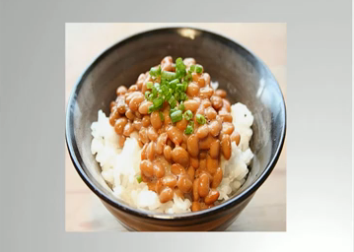
nattoh (n.) 納豆
watermelon (n.) 西瓜

Slide 17
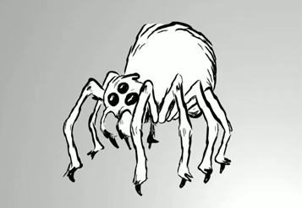
spider (n.) 蜘蛛
dolphin (n.) 海豚

Slide 18
Practice
Ask Ss follow the video and read the sentences aloud.
Divide Ss into 9 group

Slide 19
Let’s Practice!
http://www.youtube.com/watch?v=rV7X2T7nJ8o&feature=related

Slide 20
Practice
Ask Ss to ask their classmates. They need to answer the questions according to the reality.

Slide 21
Second Class Teaching goal
1. Learn to recognize colors and clothes
2. Learn to apply the vocabulary into the sentence patterns in the first class

Slide 22
Warm-up
Show Ss the video of introduction of different clothes

Slide 23
Presentation
Introduce the difference of clothes
Show the pictures and pronunciation of different clothes
Ask Ss to repeat after T
Introduce different colors
Show the pictures of different colors and teach Ss the pronunciation

Slide 24
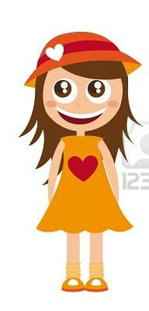
T-shirt
dress

Slide 25
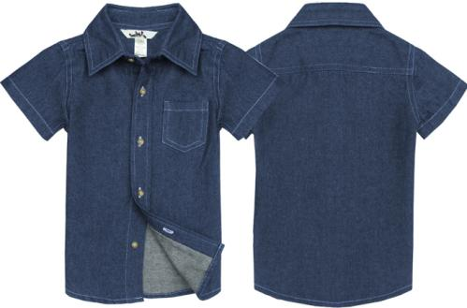
shirt
jacket

Slide 26
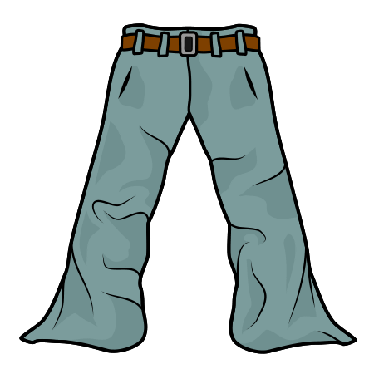
coat
pants

Slide 27
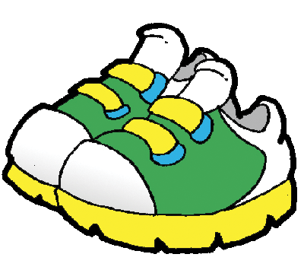
skirt
shoes

Slide 28
socks
hat

Slide 29
2nd Step: Recognizing colors!

Slide 30
Presentation
Make the vocabulary of colors gone with the vocabulary of clothes in order to make Ss describe

Slide 31
red
green
yellow
orange
white
brown
blue
black
pink
purple

Slide 32
Practice
Use ppt to make students describe colorful clothes

Slide 34
3rd Step: Recognizing clothes!

Slide 35
Practice
Let Ss answer the questions from the video
Ask if there is a volunteer to answer the questions from T

Slide 36
Let’s Practice!
http://www.youtube.com/watch?v=j62HR5lNpzw

Slide 37
Activity
Divide Ss into 9 groups
Give Ss different hint papers with clothes and colors at random
Ask them to have a dialogue of the sentence pattern in the first class with other groups according to their hint papers
Ask Ss to do the listening online test

Slide 38
1. Jimmy

Slide 39
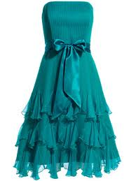
2.Melissa

Slide 40
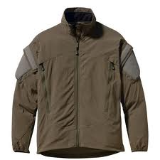
3.Mark

Slide 41
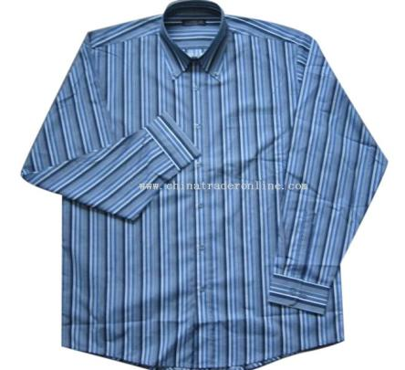
4.Bill

Slide 42
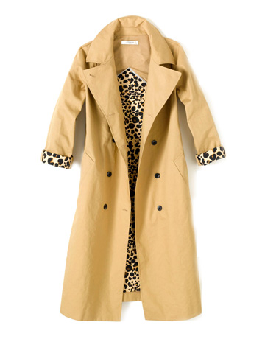
5.Jessica

Slide 43
6.Amber

Slide 44
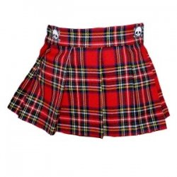
7.Cindy

Slide 45
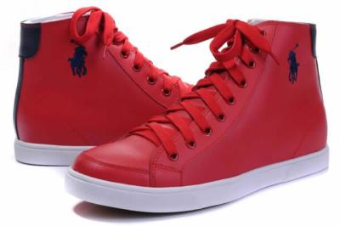
8.John

Slide 46
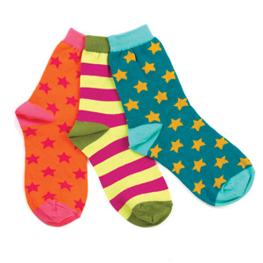
9.Doris

Slide 47
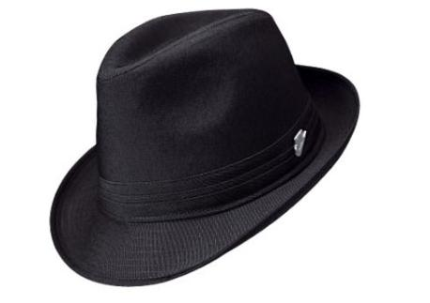
10.Eason

Slide 48
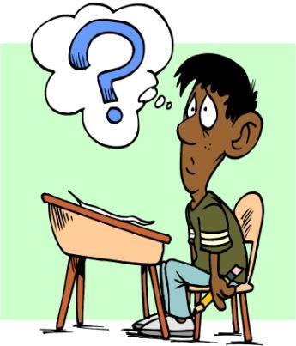
Question1:
Does Jimmy have a red
T-shirt?

Slide 49
Question2:
Does Mark have a brown jacket?

Slide 50
Question3:
Does Melissa have a blue dress?

Slide 51
Question4:
Does Bill have a yellow shirt?

Slide 52
Question5:
Does Jessica have a red coat?

Slide 53
Question6:
Does Amber have a pair of white pants?

Slide 54
Question7:
Does Cindy have a purple skirt?

Slide 55
Question8:
Does John have a pair of
blue shoes?

Slide 56
Question9:
Does Doris have a pair of orange socks?

Slide 57
Question10:
Does Eason have a green hat?

Slide 58
學生作業網站—LOXA http://www.cmjh.tn.edu.tw/

Slide 59
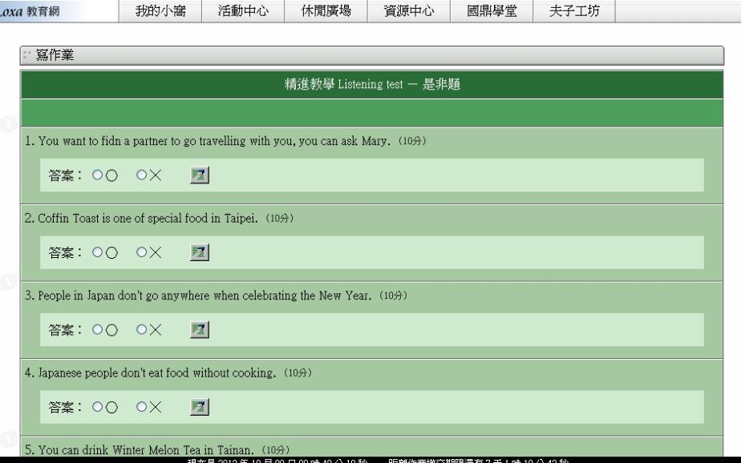
1002Listening試題介面 http://www.loxa.edu.tw/

Slide 60
Assignment
Record speaking audio files and upload to the Homework Website

Slide 61
Reference
http://www.youtube.com/watch?v=j62HR5lNpzw
.http://www.youtube.com/watch?v=gVWiDFW-nMY
http://www.youtube.com/watch?v=rV7X2T7nJ8o&feature=related

Slide 62
多元評量
Listening
Speaking
Reading Reading2
Writing, Writing2

Slide 63
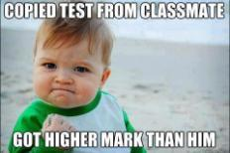
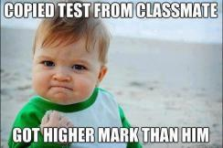
策略聯盟
差異化教學
合作學習
有效教學

Slide 64
Thank you for listening

