Slide 1
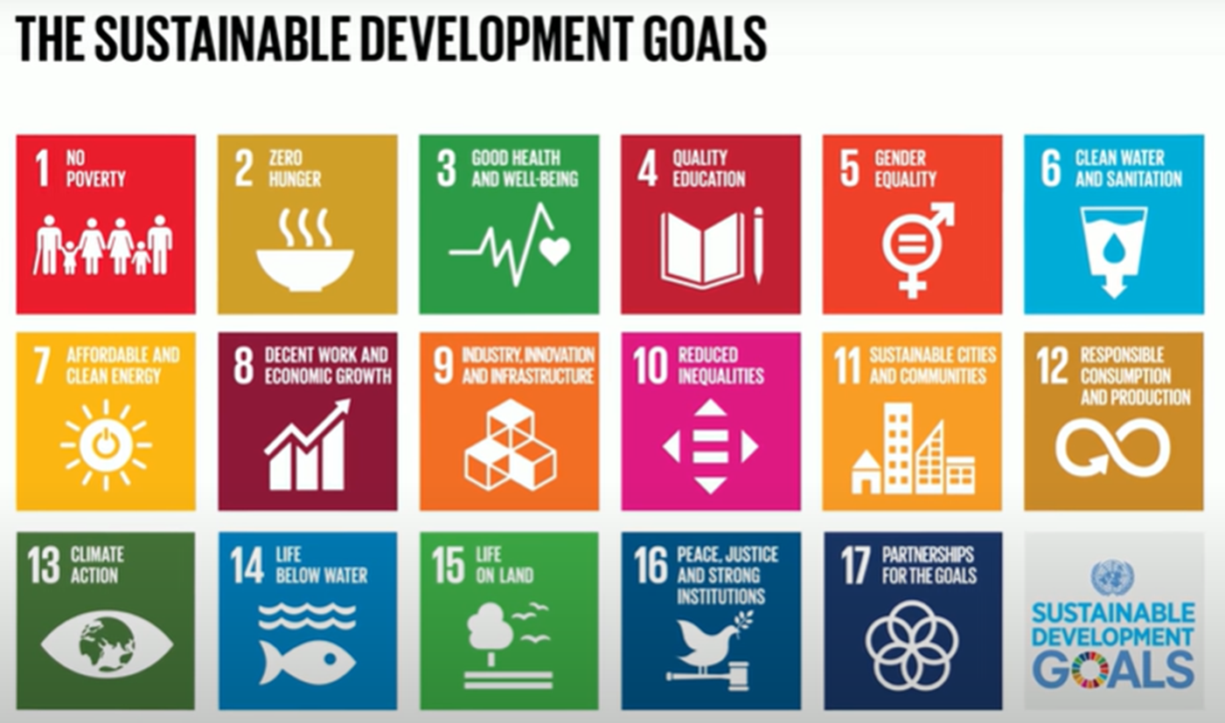
Sustainable Development Goals (SDGs)
Chongming Junior High School

Slide 2
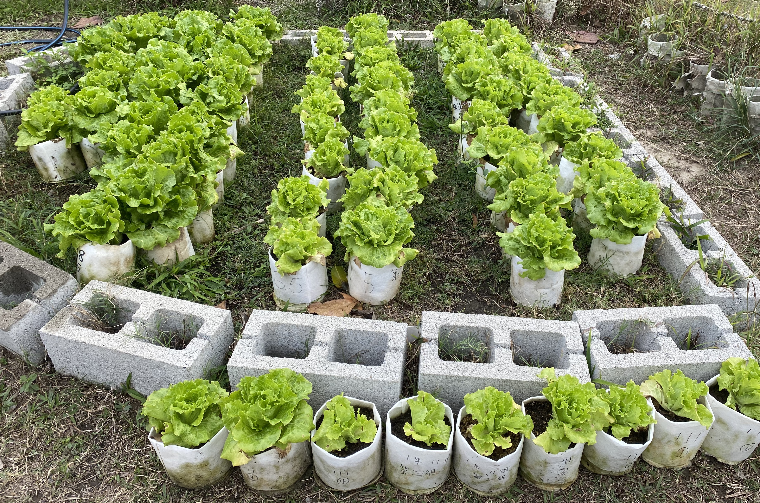
Time to Dig into Your Memory ～～～Course Review
Last semester, what homegrown vegetable did we use in our sandwiches?
What did we use to plant it?
Why did we choose this planting method?
Do you still remember me?

Slide 3
Same potting method – do you notice any differences between these three rows?

Slide 4
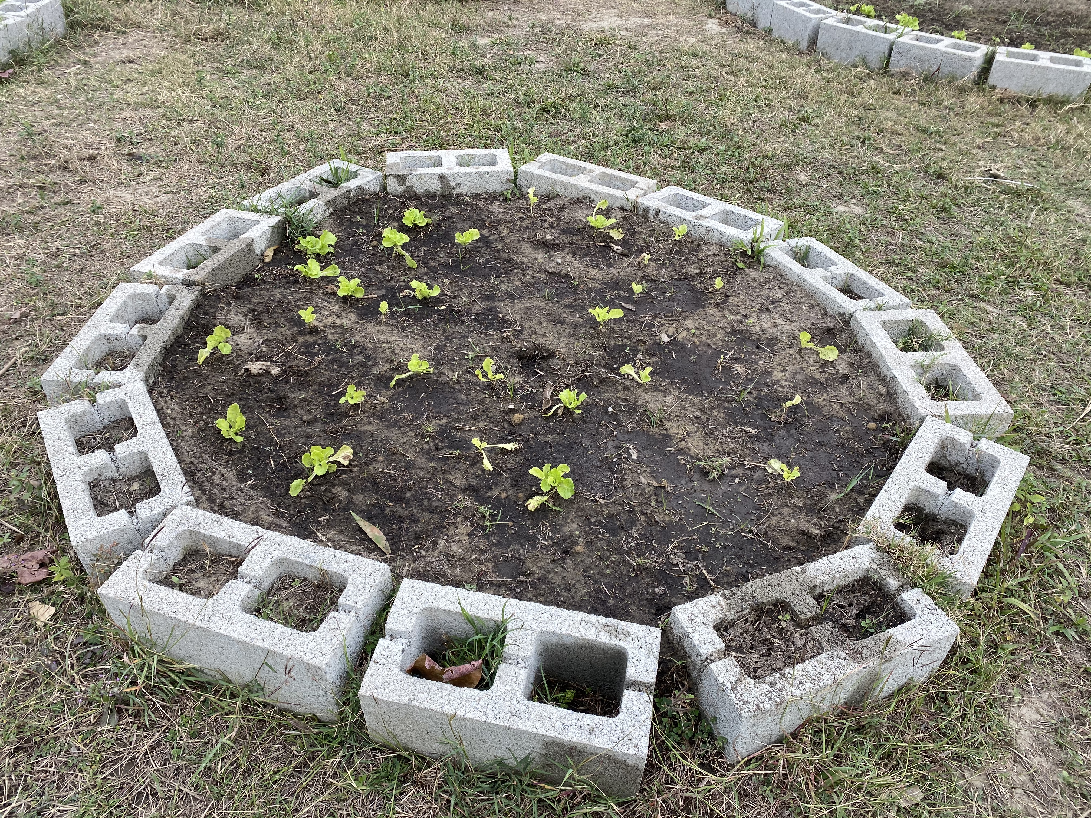
Among these vegetables that we planted at the same time, do you notice any differences between them?
What do you think are the reasons?
環境污染？！
缺乏照顧？！
陽光？！
資源不平？！
水源?!
土壤？！
空氣？!
肥料？！

Slide 5
種 植 所 需
美
植
袋
萵
苣
苖
混合土
蚯
蚓

Slide 6
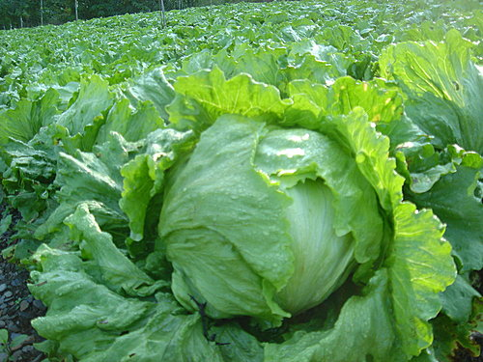
認識萵苣 Getting to know Lettuce
分類：結球、半結球、不結球
Types: Butterhead, Batavia, Leaf
紅色萵苣、綠色萵苣
Red Lettuce, Green Lettuce
栽培適期 10 月至翌 年 3 月
Planting season: October to March
生長期：一個月
Growing time: 1 month

Slide 7
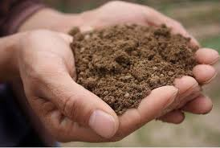
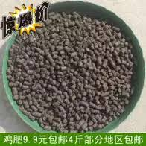
種菜步驟 Planting steps
1.取泥炭土(培養土)1/2
Take 1/2 potting soil
2.取一般土壤1/2
Take ½ regular soil
3.加15-20g的有機肥料
Add 15-20g of organic fertilizers
4.充分混合
Mix well
5.取苗
Take the seedlings
6.挖洞定位
Dig a hole
7.固定壓實
Level the soil
8.澆水
Water it
9.調整位置
Position the seedling in the hole
10.放入蚯蚓
Put in earthworms

Slide 8
◎Agricultural method
◎Consumer
◎Environment
What is the connection between these 3?

Slide 9
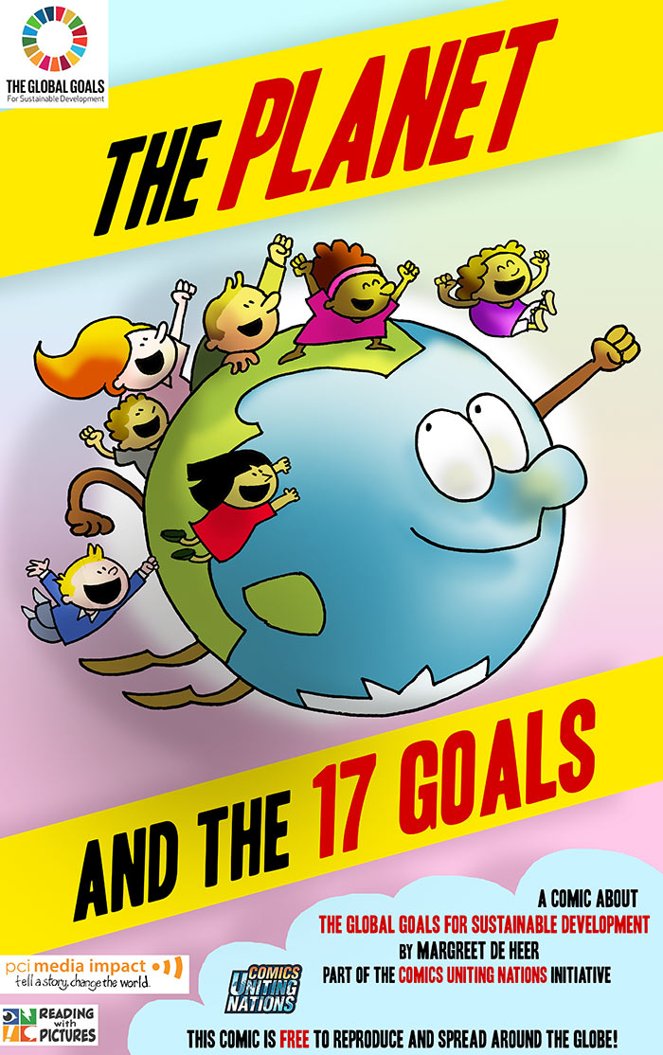
Class 2

Slide 10
Facts
One-third of the world has degraded soils; 240 billion tons of soil are lost each year.
Only 57 million hectares are used for agriculture in Taiwan.
過度使用農藥和肥料
Overuse of pesticides
and fertilizers
工業活動
Industrial Activity
豪宅林立 Housing development
畜養牲畜的廢棄物
Domesticated animal
waste
家庭使用的塑膠
Household use plastics
土地利用失序
Unwise land use
污染土壤
Soil pollution
土壤失去原來的樣貌及生產力
Soil lost its original quality and productivity

Slide 11
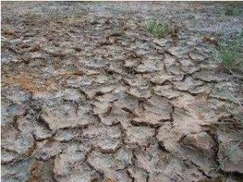
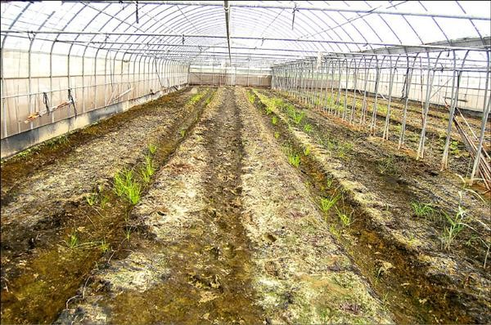
土壤鹽化及酸化
過度施肥 Overfertilization | 土壤酸化 Soil Acidification | 鹽化 Soil Salinization
土壤退化包含污染、遭到沖蝕、酸化及鹽化，土壤所含養分通常都在表土，一旦遭到大水沖刷，沒有表土就沒有養分；而施肥過量最常發生的就是及鹽化。 | 常見的肥料莫過於氮肥，但許多氮肥成分都是銨態氮（NH4+-N），容易被分解成出硝酸根及氫離子，造成土壤酸化；而過磷酸鈣過量施用時則會分解出磷酸根及氫離子，亦會使土壤酸化。 | 常發生在溫室蔬菜園中，像是蔬菜常用的肥料硫酸銨，碰水即溶，溶出來的銨最後被作物吸收，但硫酸根留在土表，加上溫室不會有降雨淋洗，久而久之就會出現鹽化，「去種滿蔬菜的溫室，彎下腰仔細看土壤，可以發現表層有一層白白的，這就是鹽化。」

Slide 12
土壤能適性發揮、永續發展
「土壤的功能性如何適當發揮，可以讓地球永續，這是土壤調查者最大的願望。」by 郭鴻裕
土壤擁有的生態、生產價值並未受到重視。
Soil ecology and production value have not been taken seriously.
農業是最能兼顧土壤生產與生態的方式。
Sustainable agriculture is the best way to balance the soil’s productivity and ecology.
聯合國糧農組織繪製全球土壤地圖。
The United Nations Food and Agriculture Organization is monitoring soil quality worldwide
泰國推農民養土冠軍。
Thailand promotes soil renewal through a competition
世界很多國家流動實驗室到田間測土壤。
Most countries around the world do research to improve their soil

Slide 13
Have you seen this picture before?
Do you know this picture?

Slide 14
What is sustainable development?
Watch video 1 (中文字幕)
https://www.youtube.com/watch?v=5yTxDO4bb30
Video speed may be switched to x 0.75
◎Please watch the video and record the key words
◎Each group will share the key content they saw in the video.
What’s the most impressive point?

Slide 16
What does “sustainable” mean?
It can keep going on and on and on (continue forever)

Slide 17
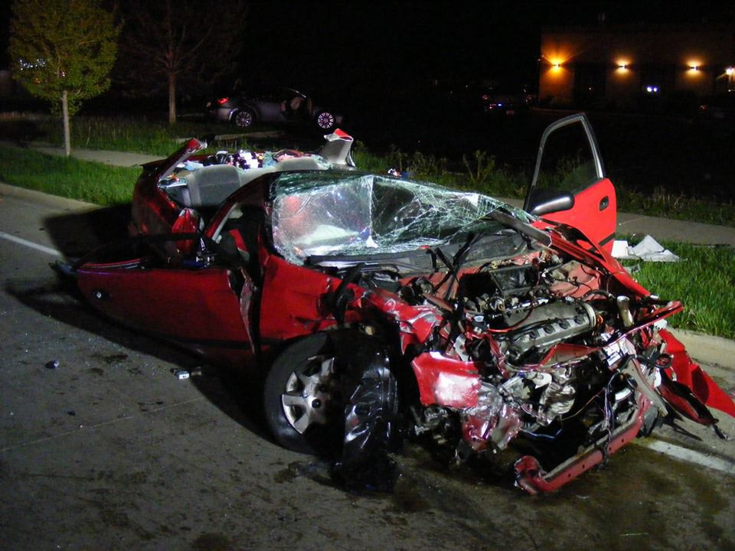
When something is not sustainable, it will eventually crash or decline
unless it is supported by something else, like the government

Slide 18
任務來囉！Unlock the SDGs
First round
Time: 5 mins
Tools: ipad, mission sheet
Mission criteria: 完成學習單的第2-3題
Pause when time’s up, turn off the ipad
Organize your own mission sheet
Leader from another table checks each group’s completion
Bonus Points Time!
小秘訣：分工合作才能創造高完成率喔！

Slide 19
Watch the video introducing the 17 SDGs
Watch video 2:
From the Millennium Development Goals (MDGs) to the SDGs
https://www.youtube.com/watch?v=5yTxDO4bb30

Slide 20
What did you see in these videos?
Out of the 17 goals, which do you think is the most important one?
What ideas or thoughts do you have?

Slide 21
Class 3

Slide 22
Focus on SDGs 3, 12 and 15
SDG 3: Good Health and Well-Being
SDG 12: Responsible Consumption and Production
SDG 15: Life on Land

Slide 23
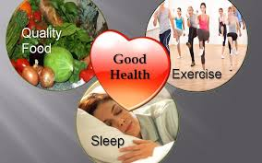
SDG 3: Good Health and Well-Being
Ensure healthy lives
Promote well-being for all, young and old

Slide 24
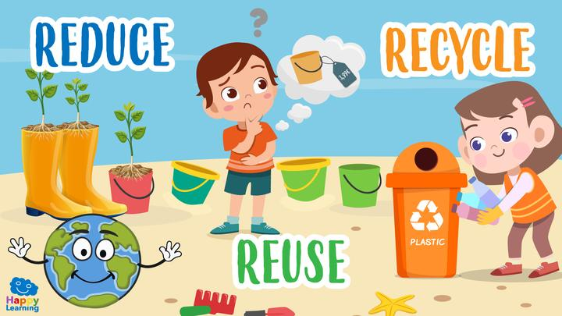
SDG 12: Responsible Consumption and Production
Don’t use things more than you need to
Reuse or recycle everything that you can

Slide 25
SDG 15: Life on Land
Protect and restore the environment
Manage forests wisely
Stop and reverse damage to the land
Stop extinctions of rare animals and plants

Slide 26
SDG Concepts Game Game to review key words and concepts

Slide 27
1. What does “sustainable” mean?
It has a lot of sugar
It costs a lot
It will never happen
It can keep going on and on and on (continue forever)

Slide 28
2.What’s wrong with something being non-sustainable?
It doesn’t taste good
It doesn’t look good
It will eventually crash or decline
It’s not much fun

Slide 29
3. Which SDG is about everyone worldwide being healthy?
SDG 9: Industry, Innovation and Infrastructure
SDG 3: Good Health and Well-Being
SDG 14: Life Below Water
SDG 7: Affordable and Clean Energy

Slide 30
4. Sustainable development means we need to keep 3 things in mind:
Social progress;
economic development;
climate and environment
Social progress;
politics;
climate and environment
Space exploration;
economic development;
social progress
Laws;
economic profit;
climate and environment

Slide 31
5. What problem affects one-third of our land worldwide?
No water
Not enough sunlight
Degraded soils
Too much rain

Slide 32
How can we help the world meet the SDGs?
What can you do to make a difference?
Here are some ideas!!
Action items
Self-evaluation: 0 (never) to 5 (always)

Slide 33
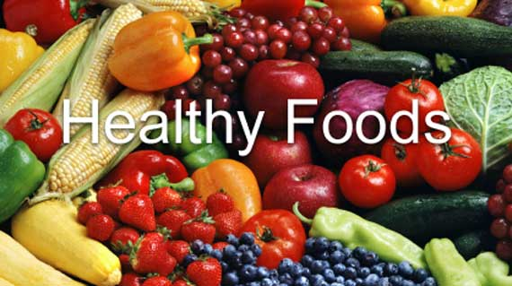
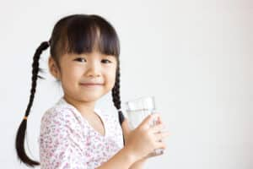
Eat a healthy diet and drink a lot of water (SDG 3)

Slide 34
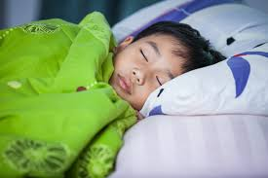
Get enough sleep (SDG 3)

Slide 35
Be more active – walk, run, swim, ride your bicycle, or do other sports. (SDG 3)

Slide 36
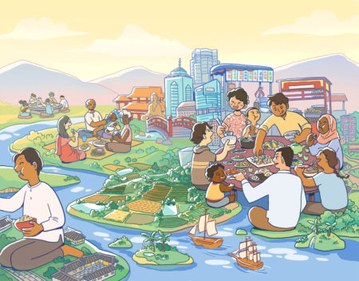
Make time for yourself and your family and friends; use your phone less! (SDG 3)

Slide 37
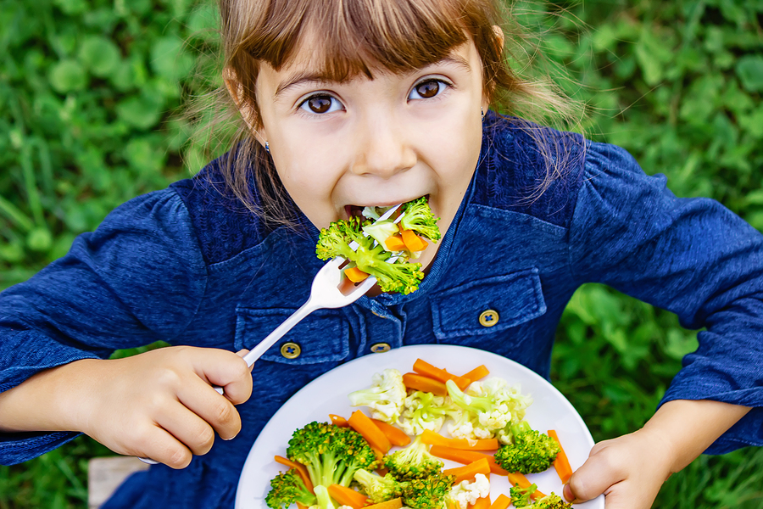
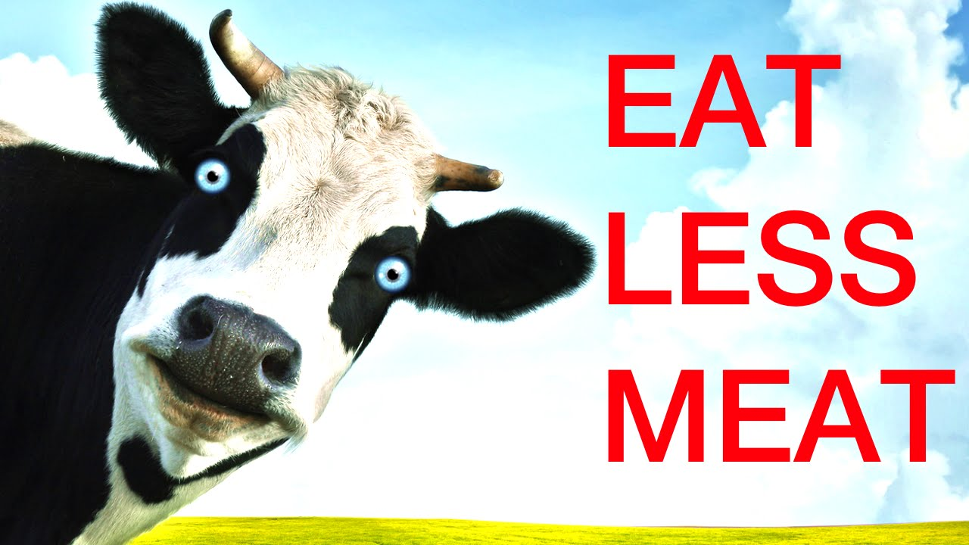
Eat less meat. Meat production and distribution greatly increases greenhouse gases. (SDG 15)

Slide 38
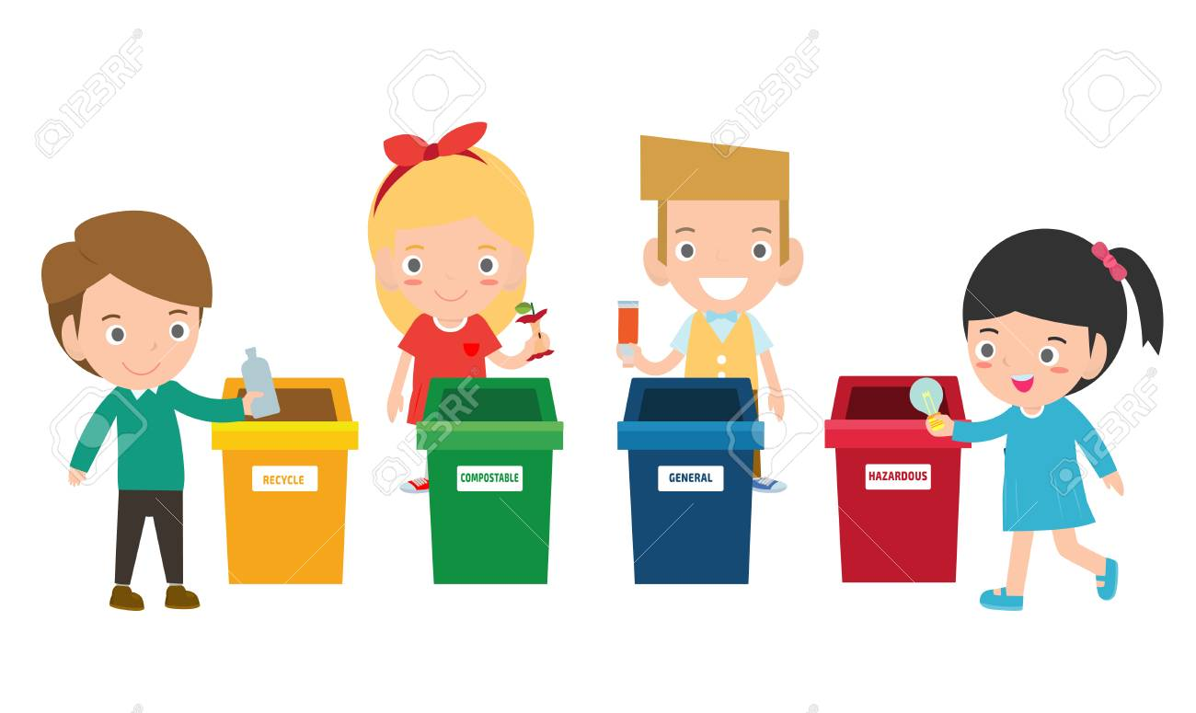
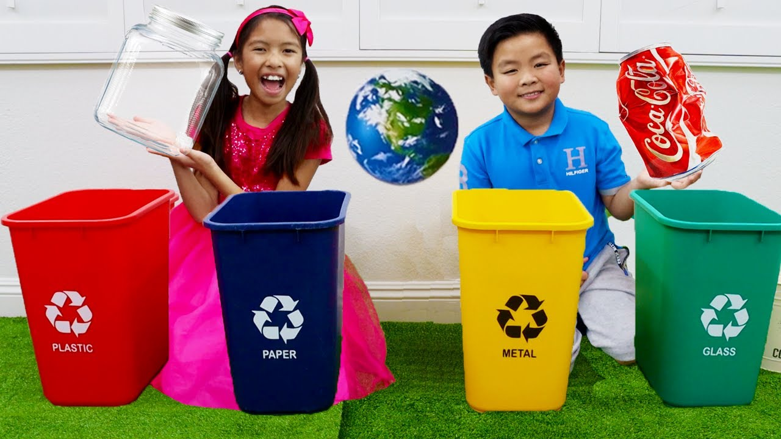
Recycle used paper and go paperless where possible. Recycle plastic and other products. (SDGs 15 & 12)

Slide 39
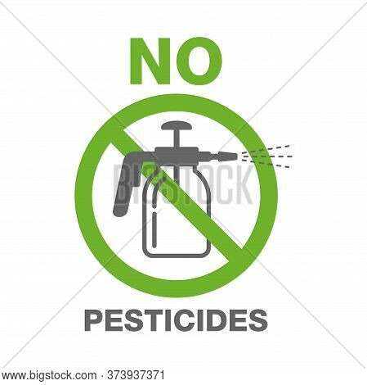
Avoid using pesticides that end up in rivers and lakes, as they are harmful to people and animals. (SDG 15)

Slide 40
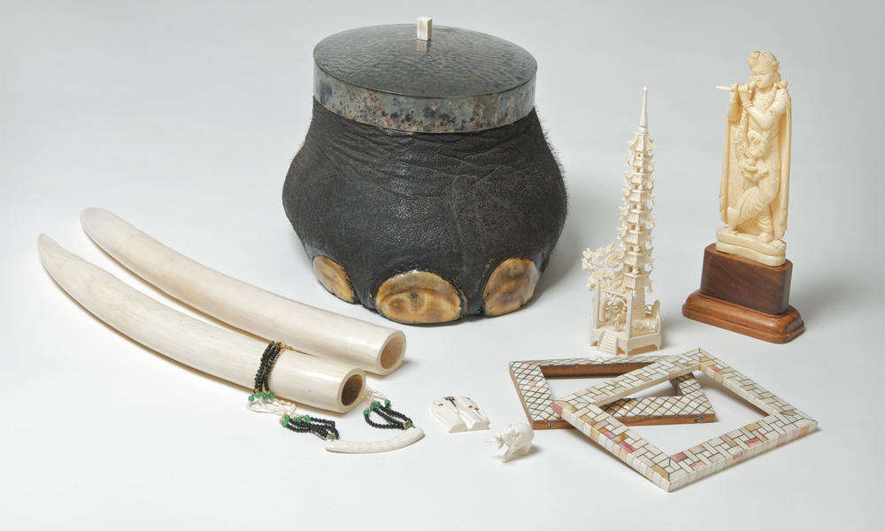
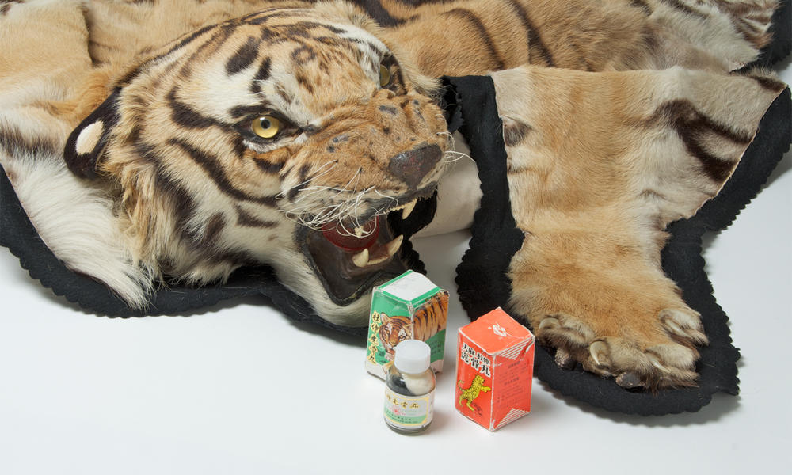
Never buy products made from threatened or endangered species (animals and plants). (SDG 15)

Slide 41
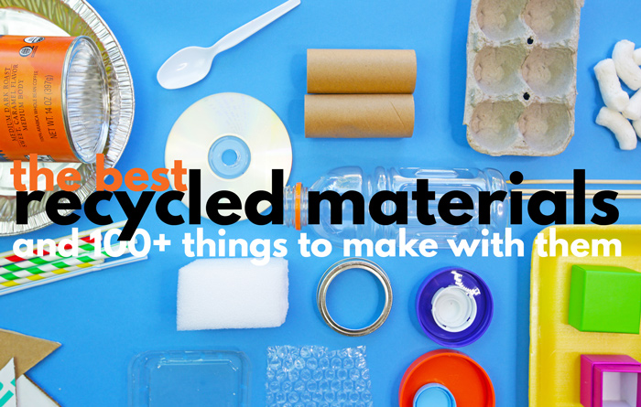
Buy recycled products. (SDG 15)

Slide 42
Buy sustainable products including electronics, toys, shampoo or seafood and organic groceries. (SDG 12)

Slide 43
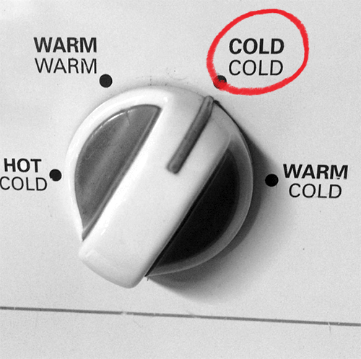
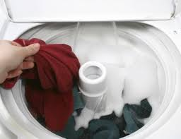
Wash your clothes in cold water. Warm water uses more energy. (SDG 12)

Slide 44
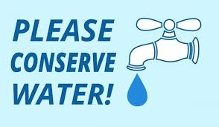
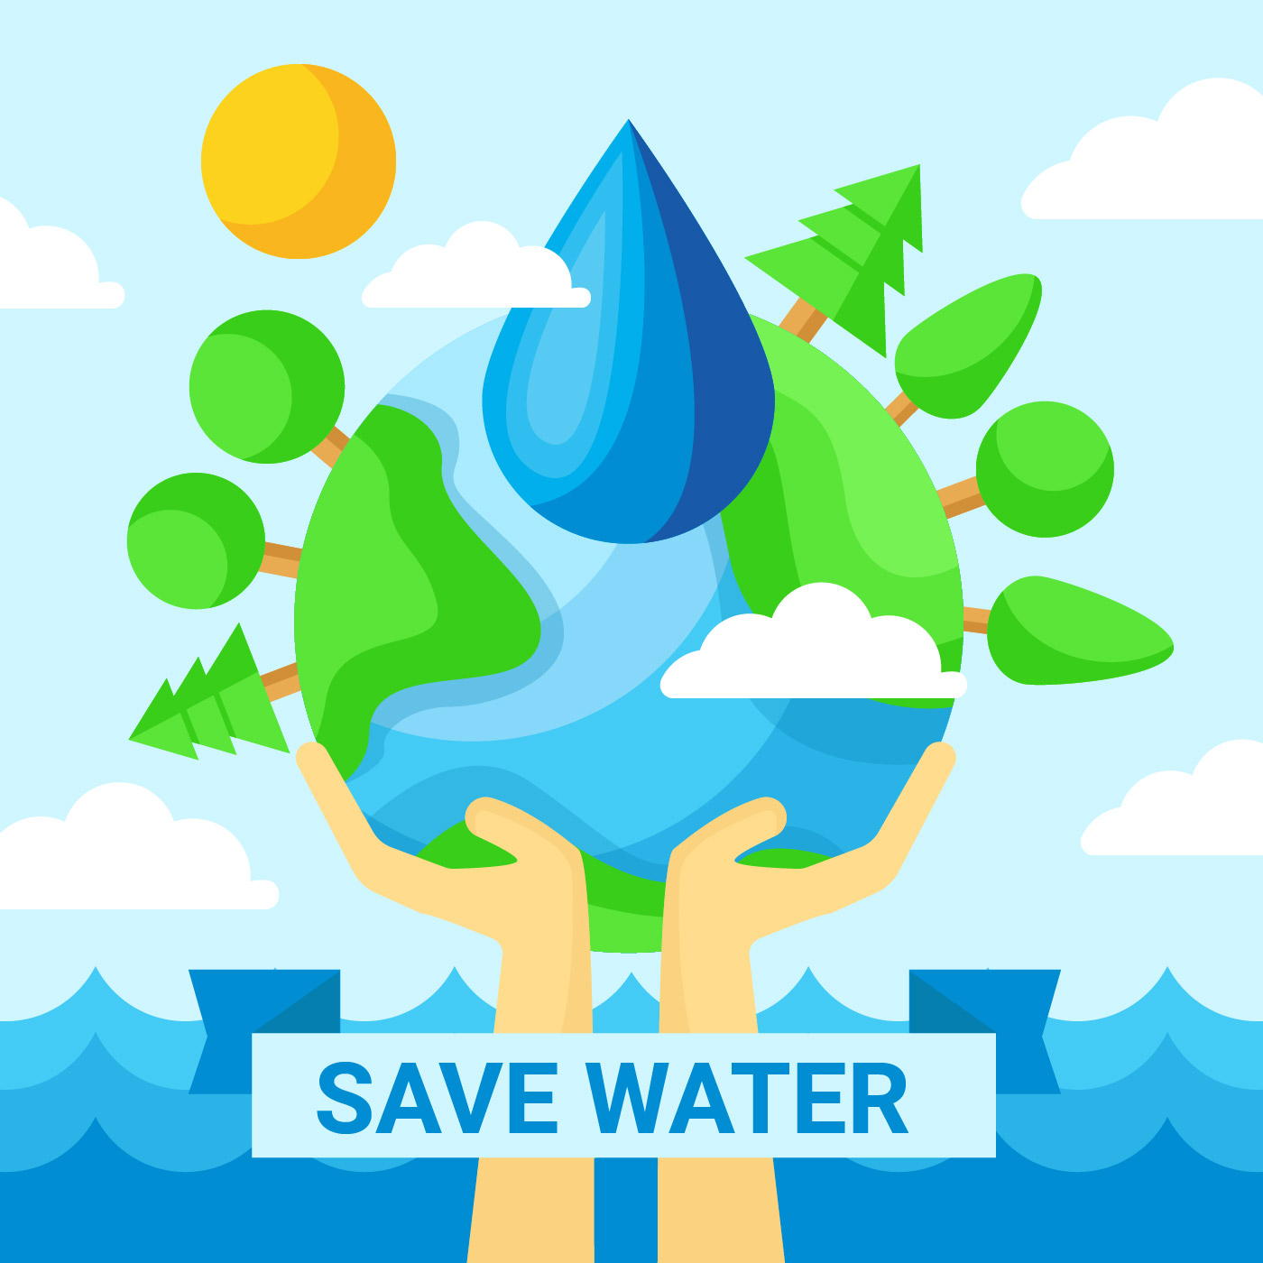
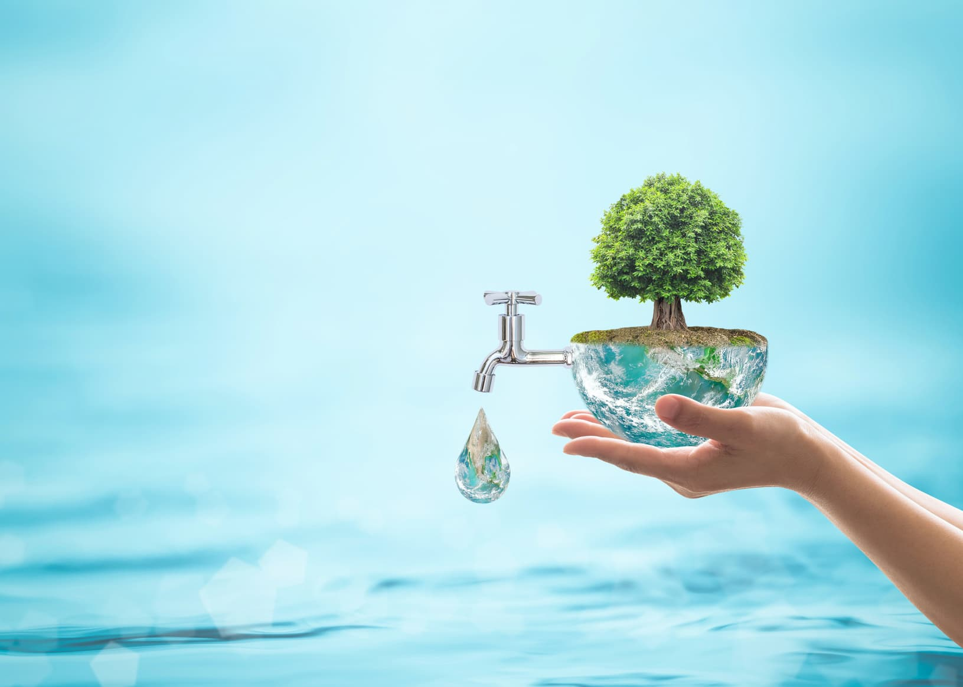
Keep showers short. Don’t fill your bathtub to the top. Using too much water contributes to global water shortages. (SDG 12)

Slide 45
Don’t buy bottled water (SDG 12)

Slide 46
My SDGs Assessment Score

Slide 47
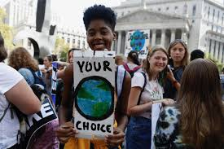
Make your own action items that help meet the SDGs!
Play the video
https://www.youtube.com/watch?v=Vef7EwZUGrs&feature=youtu.be

Slide 48
Please think of any actions that will help meet the SDGs in your daily lives.
Each group pick one SDG→
Discuss what actions you can do →
Record the actual actions and collect the pictures→
Create posters in class next week→
Present and share on stage

Slide 49
Class 4

Slide 50
Oral Presentation Grading Criteria
1. EVERY group member needs to come up
front and share.
(If everything is presented in English, your group will receive an extra 10 points)
2. Visual aid:
Use a poster to present

Slide 51
Oral Presentation Grading Criteria
3. Stage Presence:
physical stance, posture, and gestures
4. Stage etiquette:
Don’t laugh out loud, bow before and after,
and thank everyone for their attention

Slide 52
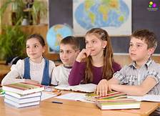
Oral Presentation Grading Criteria
5. Delivery:
voice, content, preparation, fluency,
team spirit, time management
6. Audience etiquette:
Attention to other groups’ presentations (part of your grade)

Slide 53
Oral Presentation Grading Criteria
7. Presentation timing:
3 minutes per group
a) No points deducted if over or under 30 seconds or less
b) 4 points deducted for every 30 seconds over or under
*Please note: Presentations will be recorded on video

Slide 54
Presentations ~ our SDG actions

