Slide 1
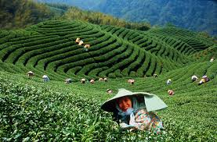
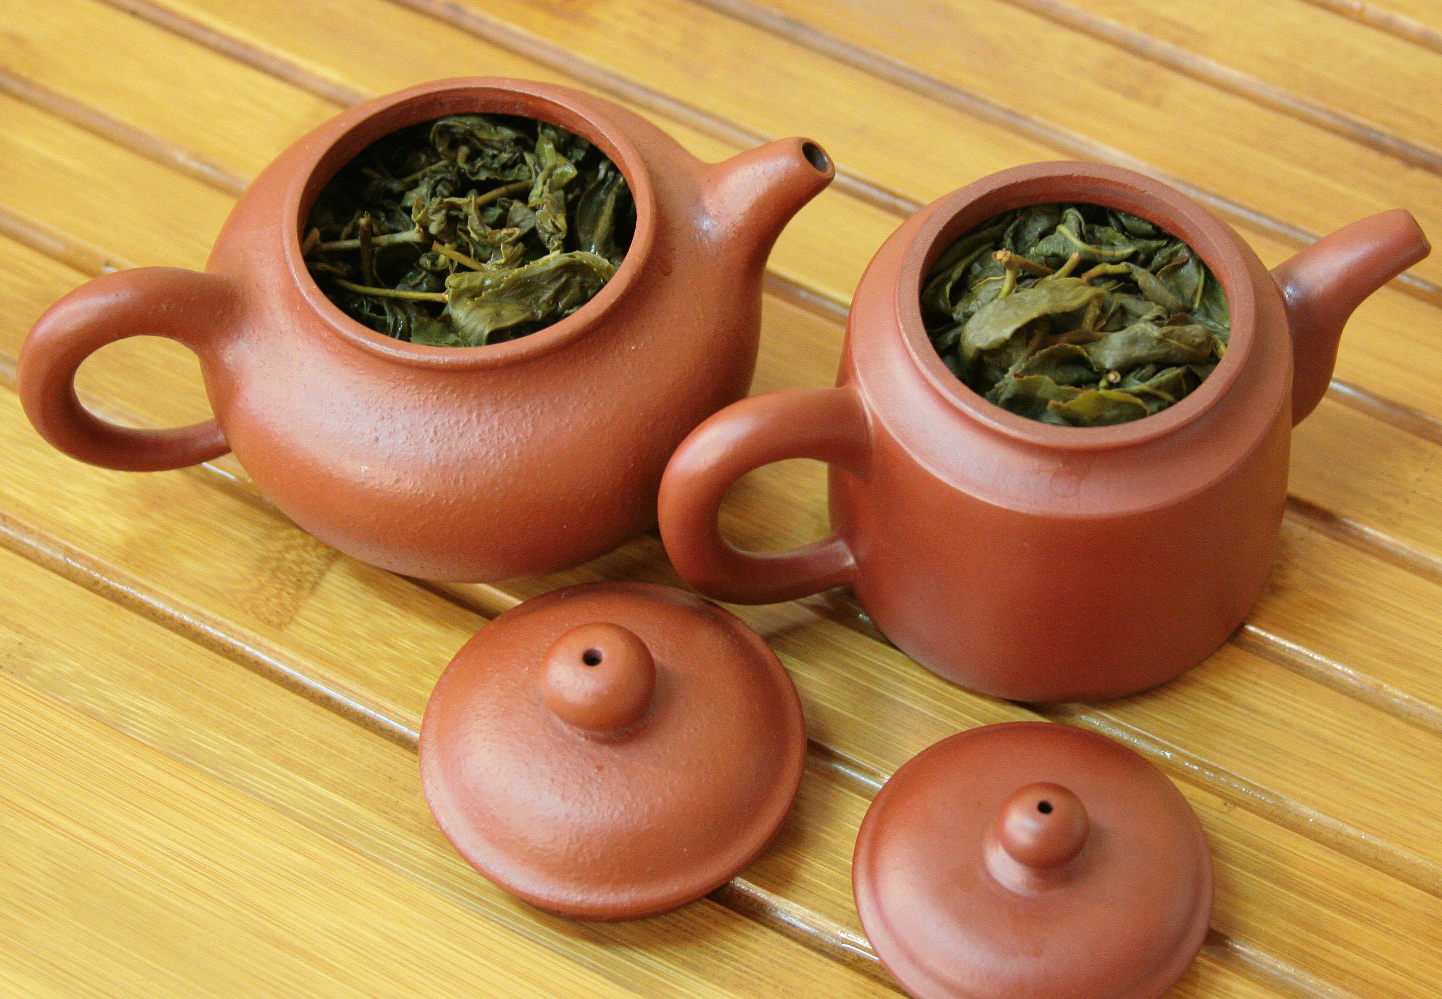
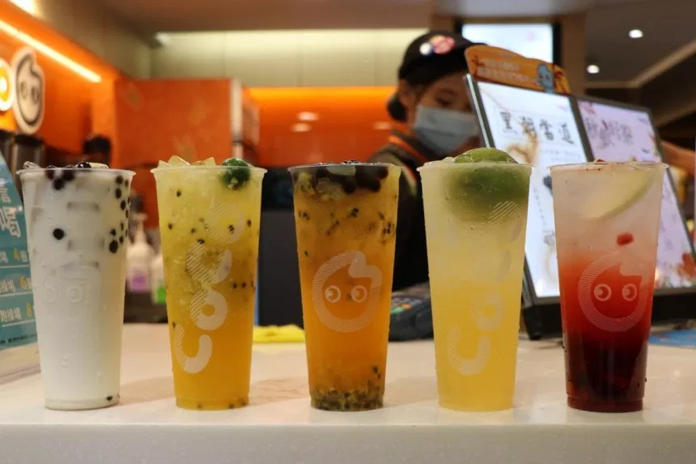
All About Tea
Content and Language Integrated Learning (CLIL) program
Chongming Junior High School, Tainan

Slide 2
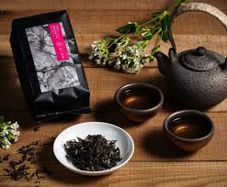
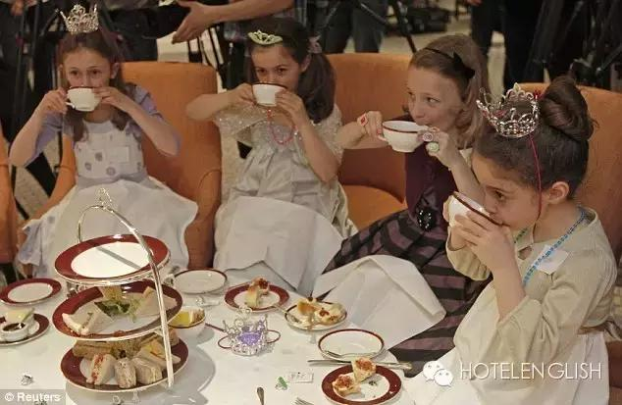
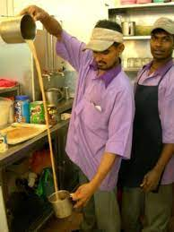
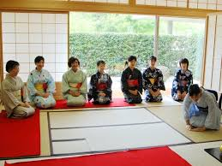
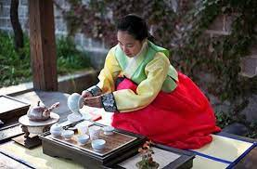
世界茶館體驗活動
1.請各組完成拼圖給的提示猜出需要完成的是哪一國的茶館體驗任務
2.解題後至前台領取體驗材料
3.體驗時間為20分鐘
4.請依照任務卡的介紹學習並完成該國的泡茶任務並以IPAD拍下全組完成任務的照片
5.請用本次所學的句型及關鍵字分享體驗心得以IPAD上傳至『 H.E生活真善美』
6.教師可依據課程剩餘時間，撥放同學的體驗作業一起欣賞

Slide 3
Directions
1. Complete the puzzle given to each group to see which country’s tea mission they have selected
2. Get the tea materials from the front desk after completing the puzzle
3. Duration: 20 minutes
4. Follow the mission cards, complete the tea mission of each country and record it with the ipad
5. Share your thoughts using the target sentences and upload the activity pictures in the right place
6. Teachers may use the remaining time to share their tea mission activity pictures with the whole class

Slide 4
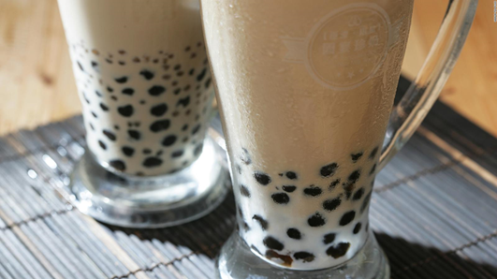
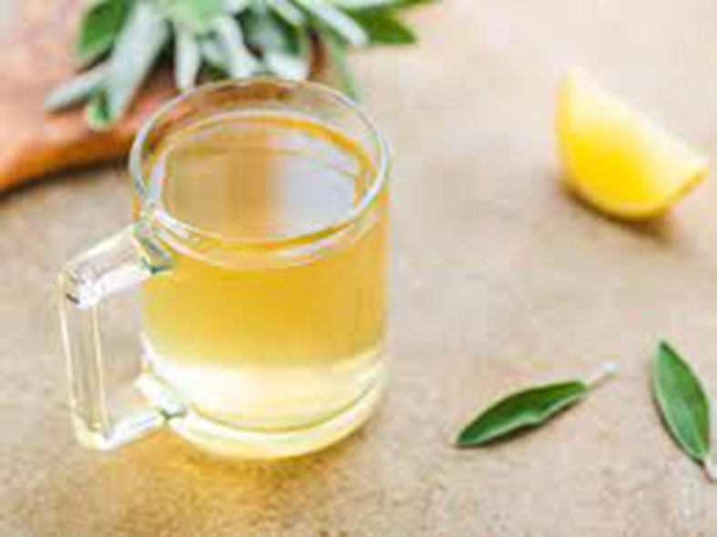
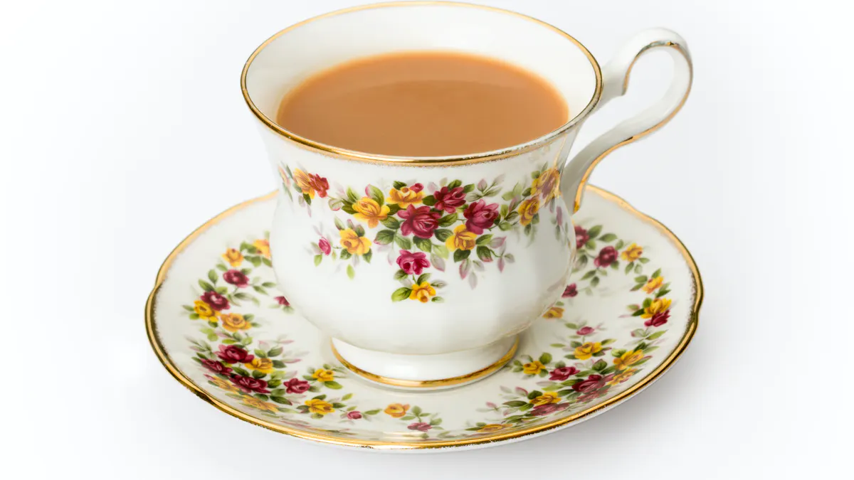
Target sentences
1. Hello! We are Class _____ and Group ______.
2. Our tea is from _________________ (name of country).
3. We like _____________ tea because it tastes _________________. (strong, weak, bitter, sweet, spicy, flowery, fruity)
4. One interesting fact about _____________ tea is: ____________.

Slide 5
One interesting fact about ____________________ tea is:
Masala Chai (India)
One interesting fact about masala chai is that it helps with sleep and stress relief.
Oriental Beauty Oolong Tea (Taiwan)
One interesting fact about Oriental Beauty Oolong tea is that it tastes better after the leafhopper sucks on the tea leaf.
Matcha Tea (Japan)
One interesting fact about matcha tea is that it’s disrespectful to use strong-smelling perfume at a Japanese Tea Ceremony.
English Tea (England)
One interesting fact about traditional English afternoon tea, also called low tea, is that it starts at 4:30pm.
Corn Silk Tea (Korea)
One interesting fact about corn silk tea is that Native Americans have been using it since 5000 BC as an herbal remedy for various diseases.

Slide 6
CLASS 2

Slide 7
Preparation
10 minutes to prepare your presentation
1. Hello! We are Class _____ and Group ______.
2. Our tea is from _________________ (name of country).
3. We like _____________ tea because it tastes ______________ (strong, weak, bitter, sweet, spicy, flowery, fruity)
4. One interesting fact about _____________ tea is ____________.

Slide 8
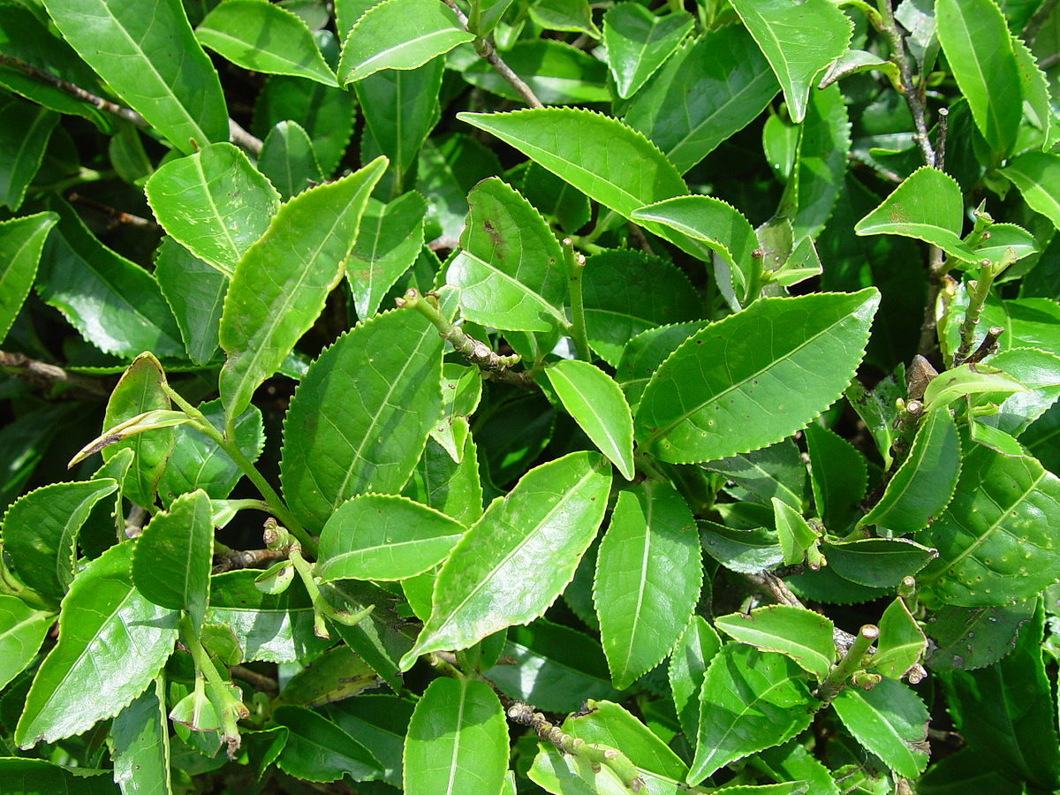
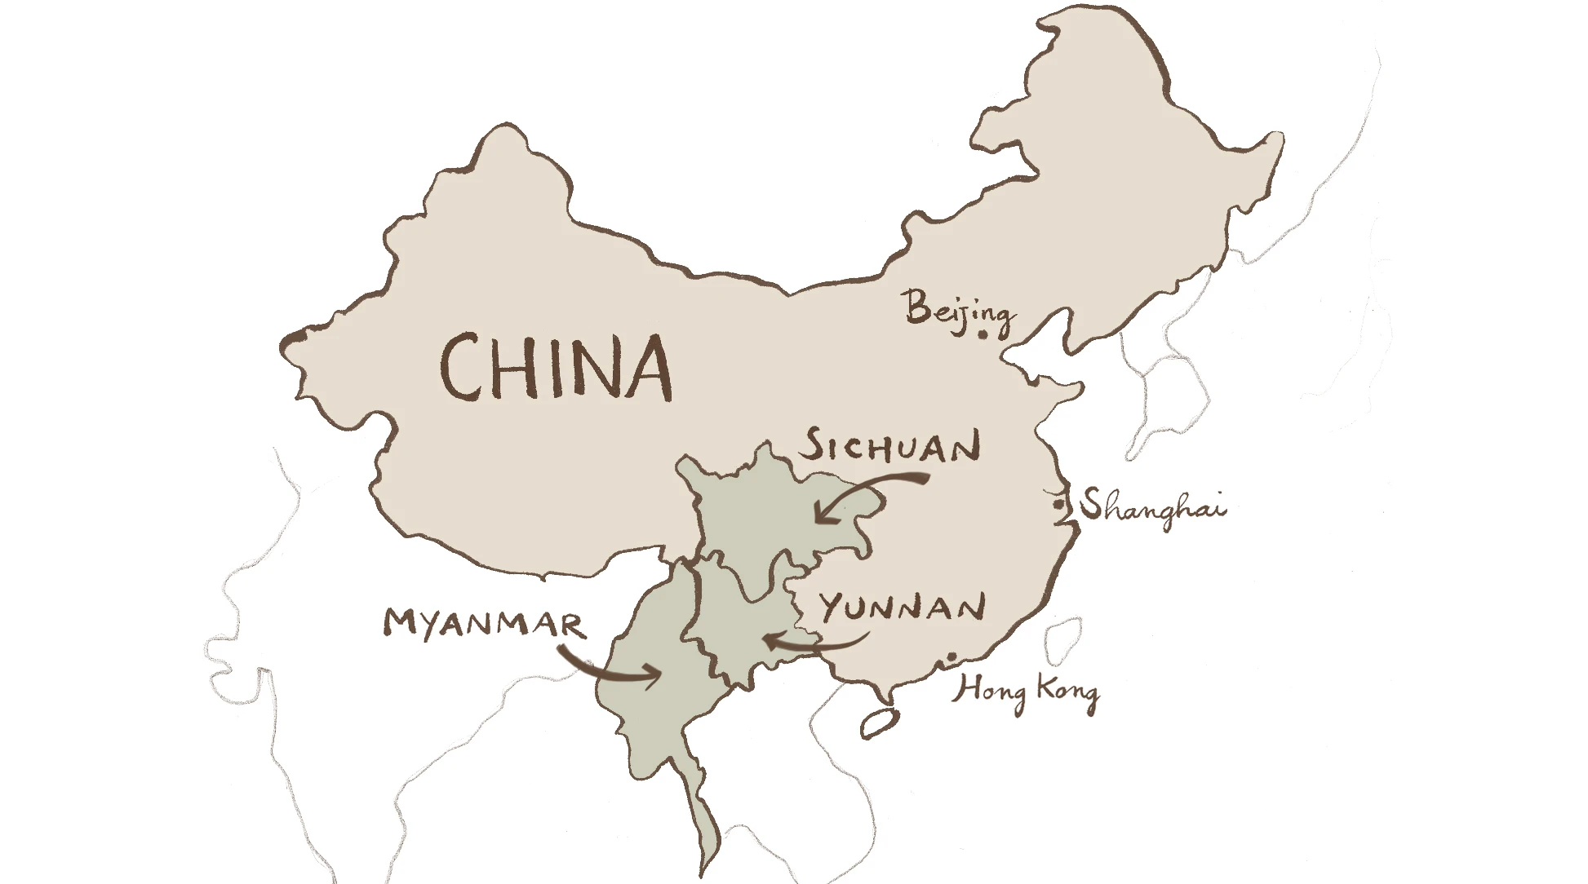
All about tea – fun facts
Tea is originally from Southwest China, near Myanmar
Origin = where something is from
Originally used as medicine during the Shang Dynasty

Slide 9
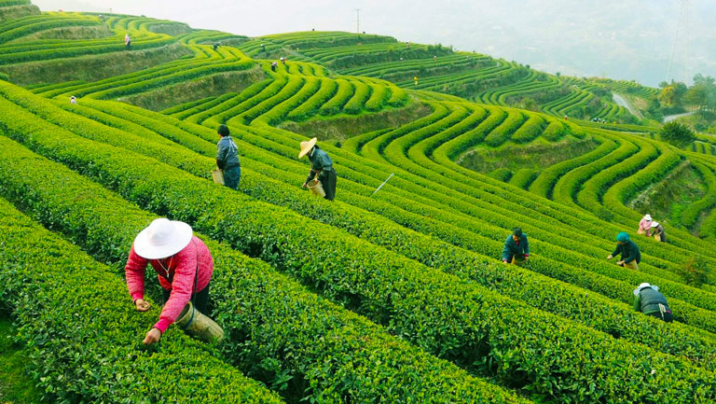
Top 3 countries that grow the most tea
China
India
Kenya
Tea plantation in China

Slide 10
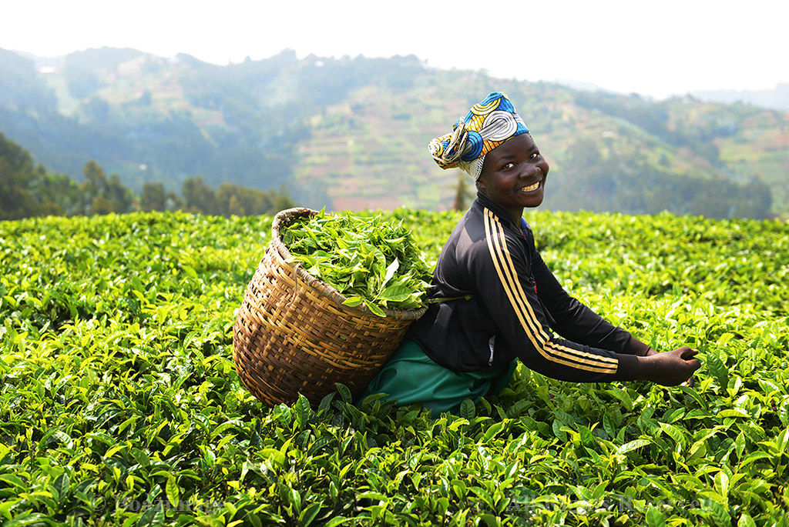
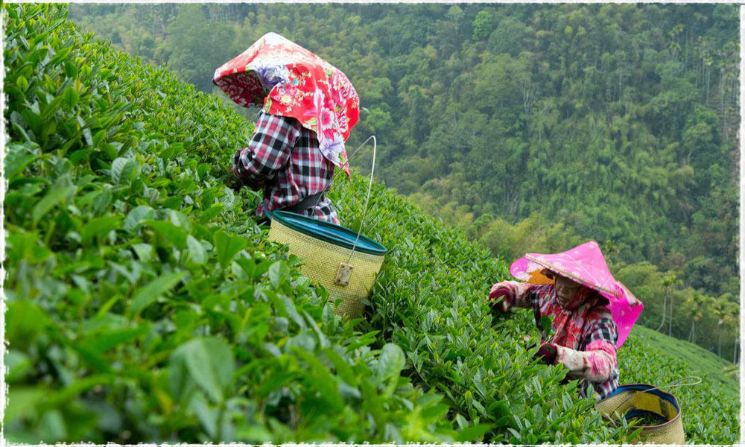
How tea is grown and harvested
Tea plants are ready for harvesting about 3 years after planting
Tea is mainly grown in tropical and subtropical climates
Young leaves produce the best quality tea
Picked by hand

Slide 11
Countries that drink the most tea per person

Slide 12
Countries that drink the most tea per person

Slide 13
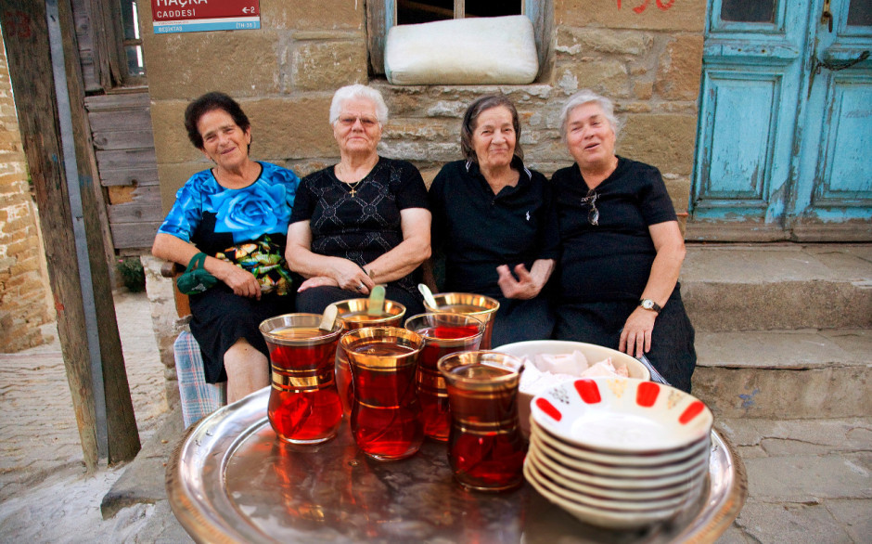
Countries that drink the most tea per person
Turkey 3.16 kg per year
Ireland 2.19 kg
United Kingdom 1.94 kg
.
.
10. Japan 0.97 kg
19. China 0.57 kg
28. Taiwan 0.29 kg
Drinking tea in Turkey

Slide 14
Agriculture

Slide 15
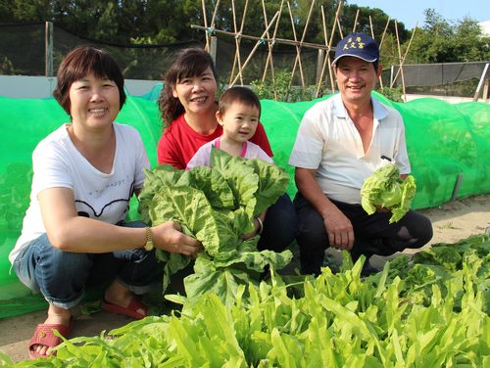
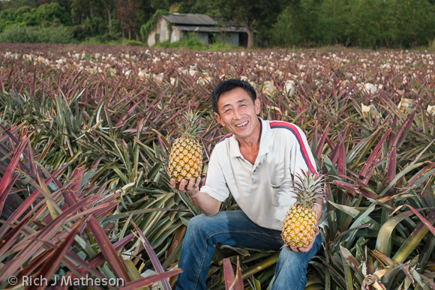
What is agriculture?
Farming
The production of plants and animals for people to use in different ways
Eating
Clothing
Industry

Slide 16
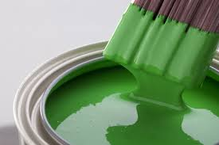
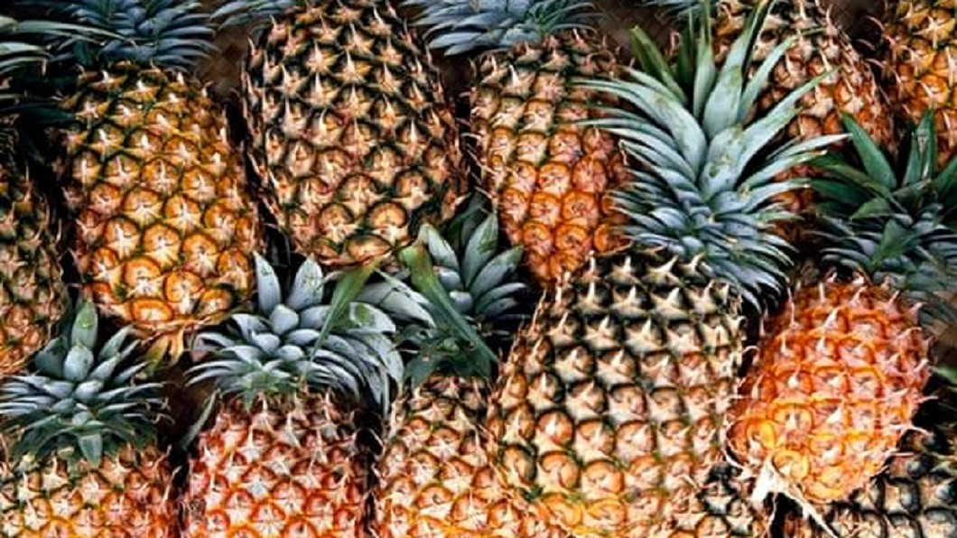
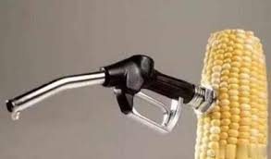
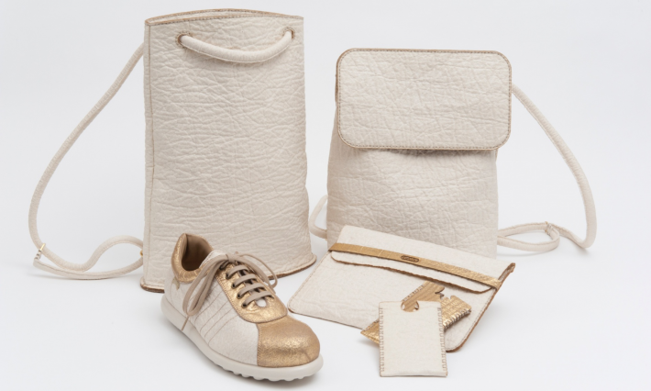

Slide 17
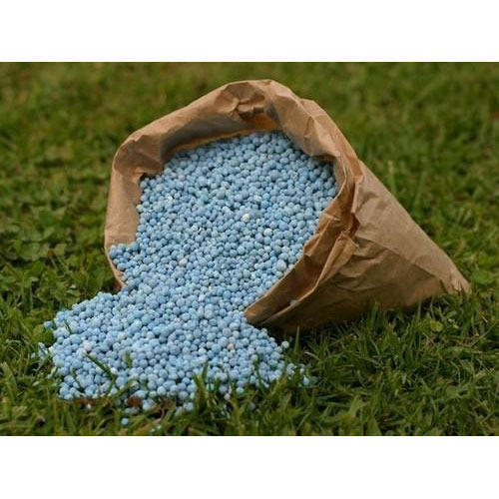
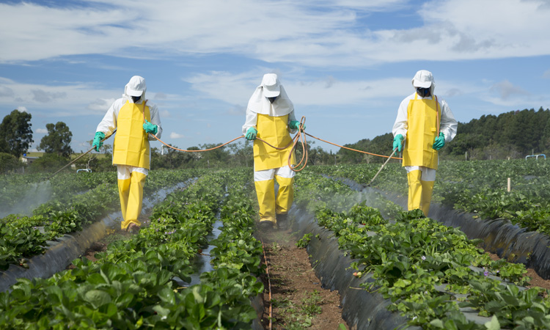
Conventional agriculture
Many chemical inputs such as pesticides and fertilizers are used
Many kinds of chemical pesticides are harmful to human health and the environment
Chemical fertilizers are also harmful if used in excess

Slide 18
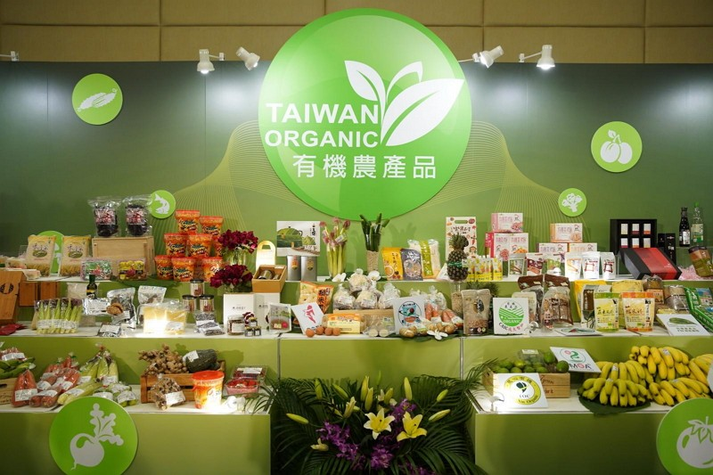
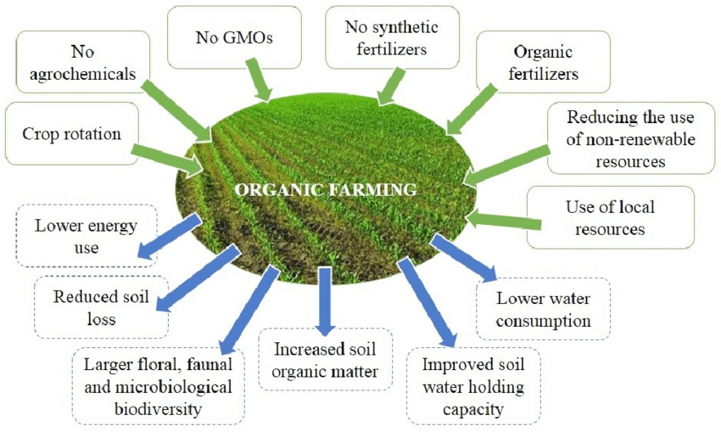
Organic agriculture
Natural and healthy, if done right
No chemical pesticides and fertilizers allowed

Slide 19
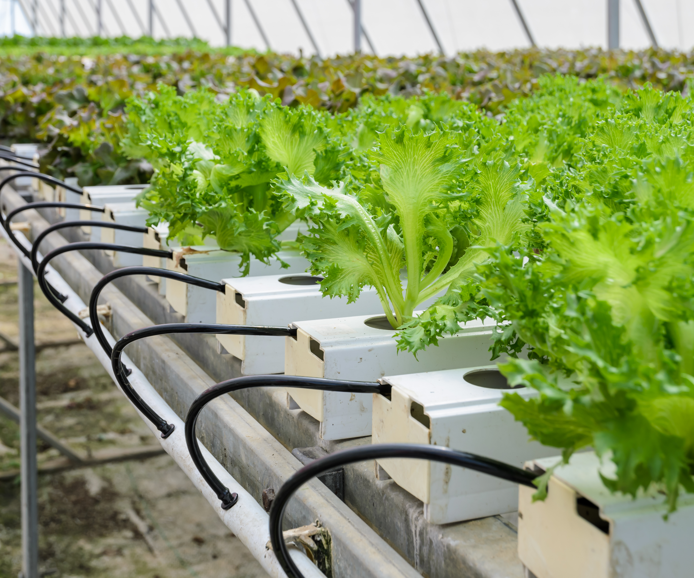
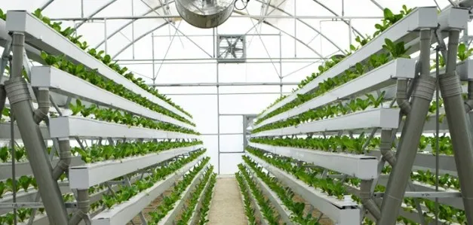
Hydroponics
No soil used
Fertilizer added into the water for the plant roots

Slide 20
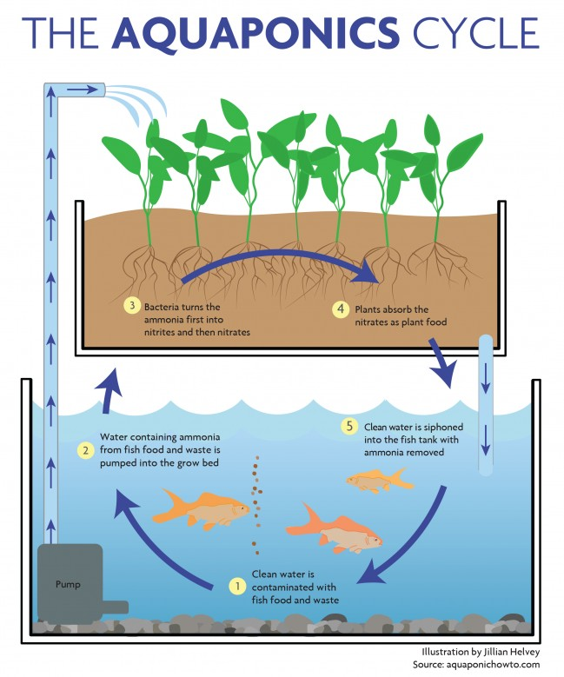
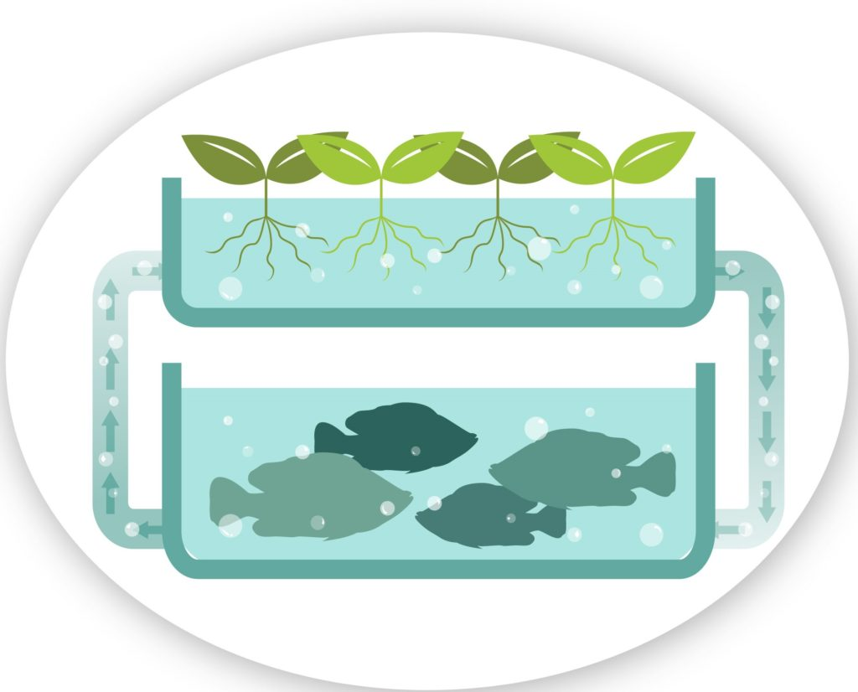
Aquaponics
Plants are grown in a circulating system with fish
Fish poop fertilizes the plants
Natural and healthy, if done right

Slide 21
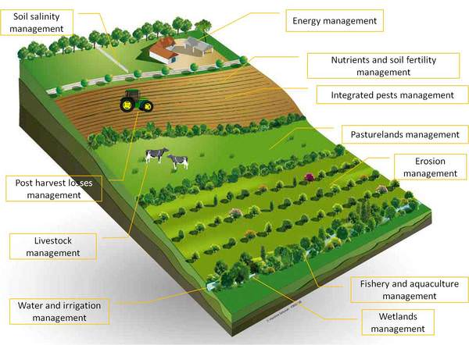
What is sustainable agriculture?
This kind of agriculture can keep going on and on and on (continue forever)

Slide 22
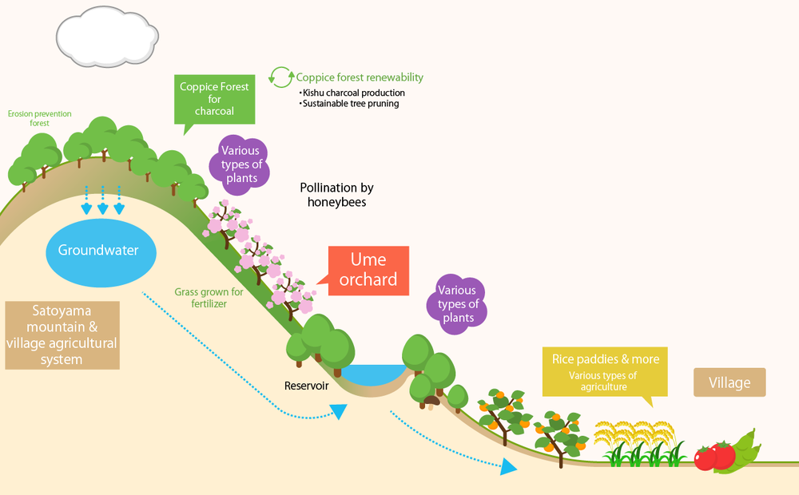
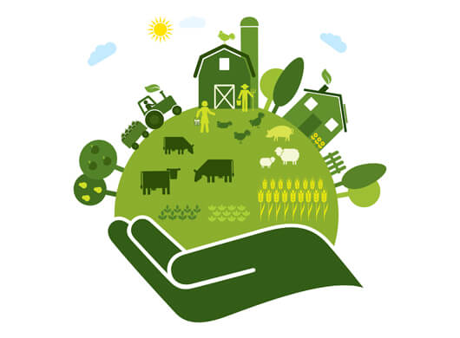
How does it help us? Sustainable agriculture is:
Environmentally-friendly:
does not damage the environment and may even improve it
2. Economically profitable:
farmers need to make money to keep doing it, otherwise they will quit
3. Healthy: helps people and makes them healthier; does not harm them

Slide 23
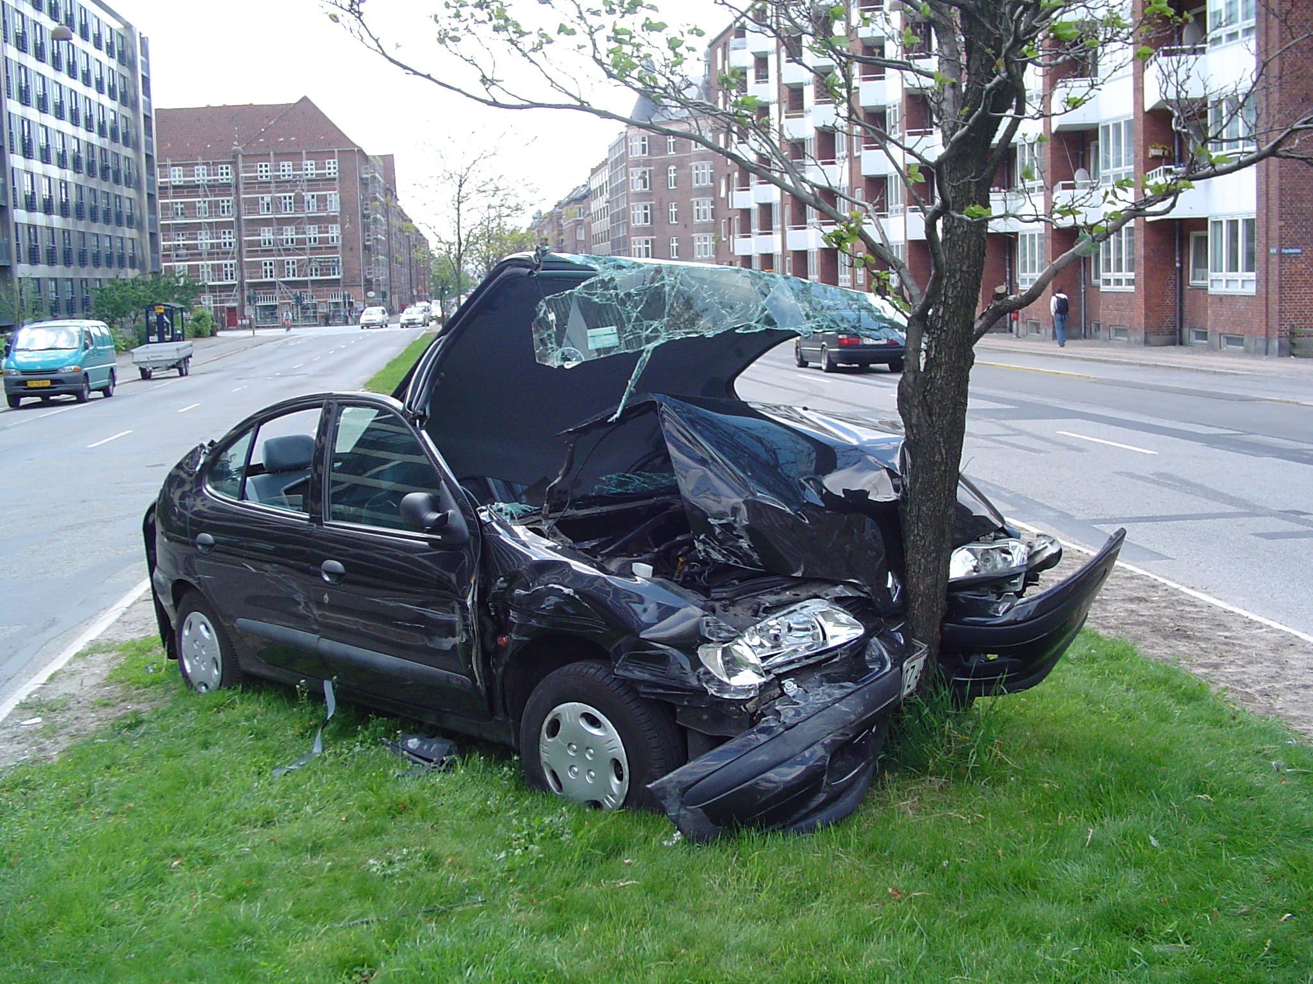
Sustainable agriculture
If it’s not sustainable, it will eventually crash or decline

Slide 24
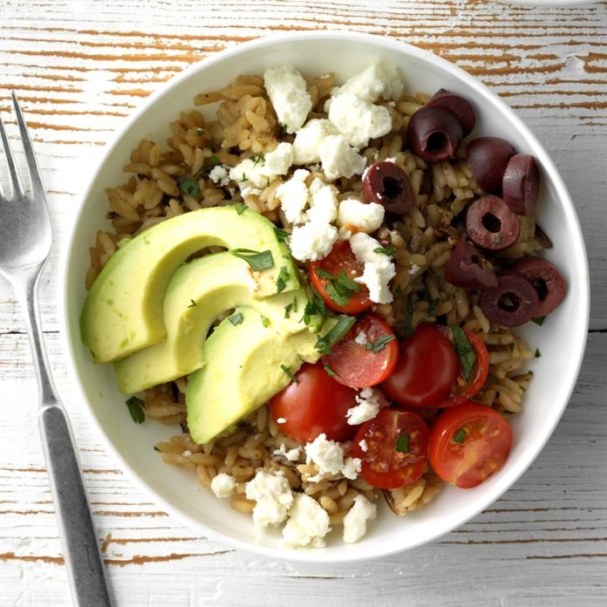
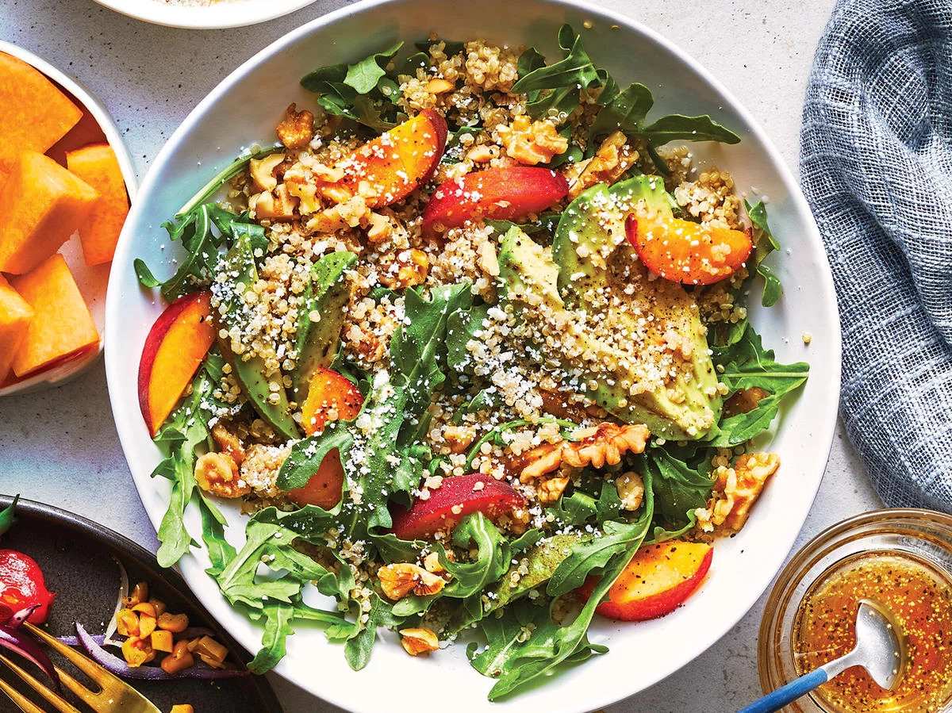
Sustainable agriculture
What can you do to save the earth?
Eat one vegetarian meal a day
Don’t use harmful pesticides in your own garden
Ask your government to ban harmful pesticides
Vegetarian meals

Slide 25
Class 3

Slide 26
Activity: Kinds of agriculture
Match cards of names of each kind with their features

Slide 27
Game to review key words and concepts
Review Game!
Rules: explained in Chinese
1.Be quiet
2.Raise your answer card when
the teacher says, “Go!”
3.Only one answer per group
A
B
C
D

Slide 28
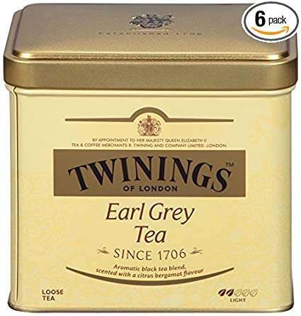
Kahoot review Q1
Name 3 kinds of tea
COVID tea, milk tea and green tea
Green tea, black tea and mint tea
Black tea, orange tea and lettuce tea
Herbal tea, green tea and pork tea

Slide 29
Kahoot review Q1
Name 3 kinds of tea
COVID tea, milk tea and green tea
Green tea, black tea and mint tea
Black tea, orange tea and lettuce tea
Herbal tea, green tea and pork tea

Slide 30
Kahoot review Q2
What are the two most important parts of an aquaponics system?
Soil and water
Fish and plants
Pipes and water
Fish and pipes

Slide 31
Kahoot review Q2
What are the two most important parts of an aquaponics system?
Soil and water
Fish and plants
Pipes and water
Fish and pipes

Slide 32
Kahoot review Q3
Which countries drink the most tea, per person?
USA, United Kingdom and Taiwan
China, India, Kenya and Japan
Turkey, Ireland and United Kingdom
Indonesia, Taiwan and China

Slide 33
Kahoot review Q3
Which countries drink the most tea, per person?
USA, United Kingdom and Taiwan
China, India, Kenya and Japan
Turkey, Ireland and United Kingdom
Indonesia, Taiwan and China

Slide 34
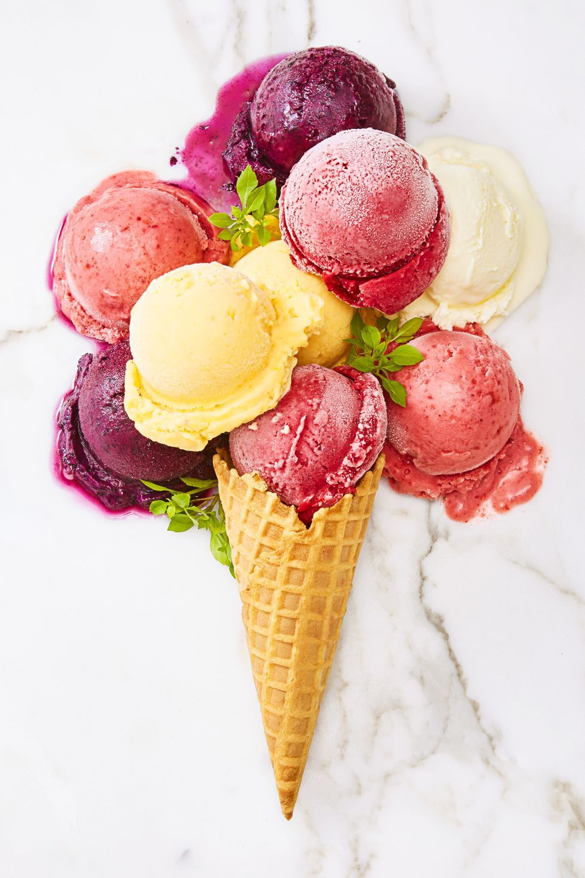
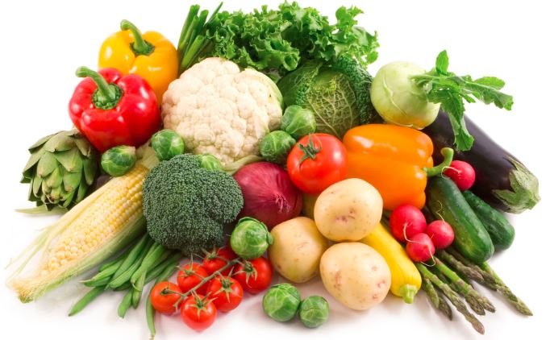
Kahoot review Q4
What can you do to help save the earth?
Don’t eat in restaurants while COVID-19 is still a threat
Eat as much meat as you possibly can
Eat one vegetarian meal a day
Eat a lot of ice cream

Slide 35
Kahoot review Q4
What can you do to help save the earth?
Don’t eat in restaurants while COVID-19 is still a threat
Eat as much meat as you possibly can
Eat one vegetarian meal a day
Eat a lot of ice cream

Slide 36
Next week: Learn more about Tea Culture

